Slide 1
Transgender Day of Visibility
March 31
Student Health & Human Services
Office of Human Relations, Diversity & Equity
July 2022

Slide 2
Would you rather...
Be
Be able to talk to land animals
Be
Be able to talk to animals that can fly
Be
Be able to talk to animals that live underwater

Slide 3
Objectives
Learn about Transgender Day of Visibility
1
Discuss the importance of the day
2
Identify what you can do to support the transgender community
3

Slide 4

What is Transgender Day of Visibility?
The event celebrates the resilience and success of transgender and gender nonconforming people and raises awareness of transgender rights.

Slide 5
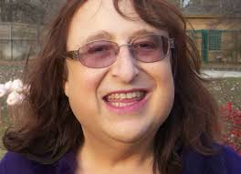
The History
TDoV was founded by activist Rachel Crandall in 2009.
Crandall was inspired by the fact that there was no holiday in existence dedicated to honoring the achievements and contributions of transgender people.
At the time, the only major transgender-centered commemoration was the Transgender Day of Remembrance, which mourns the victims of hate crimes and violence.

Slide 6
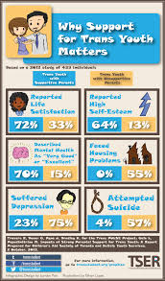
The Facts
In 2017, 1 in every 250 adults, or almost 1 million Americans identify as transgender.
Approximately 150,000 American youth ages 13-17 identify as transgender
https://williamsinstitute.law.ucla.edu/wp-content/uploads/1701-Age-of-Transgender-US-FIG-1.png
Meerwijk, E. L., & Sevelius, J. M. (2017). Transgender Population Size in the United States: a Meta-Regression of Population-Based Probability Samples. American journal of public health, 107(2), e1–e8. https://doi.org/10.2105/AJPH.2016.303578

Slide 7
What do you think?
Rachel Crandall founded this day because of the lack of visibility of transgender people.
Do you think this is still true today? Why or why not?

Slide 8

Josie Totah on the Importance of Trans Day of Visibility
Notes:
https://youtu.be/kBmakndkAI0
4:19

Slide 9
What do you think?
In the video, Josie talks about the importance of Transgender Day of Visibility.
Do you agree or disagree with Josie? Why or why not?

Slide 10
What can you do?
Celebrate
Celebrate the day by reminding the trans people in your life that you accept them, you love them, you support them
Add
Add your pronouns to your zoom name so people in your classes know that your trans peers know you are supportive
Use
Use gender neutral pronouns to address someone when you don't know their gender identity and how they prefer to be addressed
Display
Display your support by using trans-friendly zoom backgrounds
Join
Join a GSA as a supporter

Slide 11
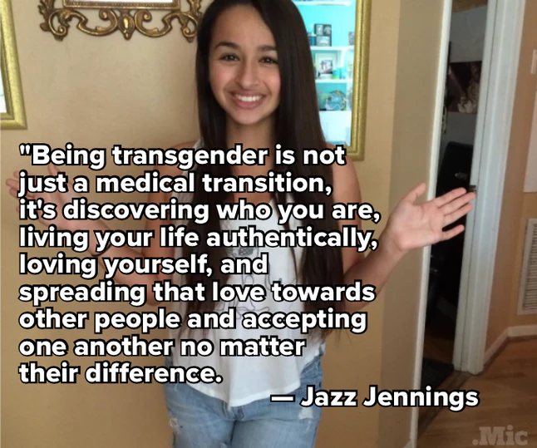
Check out
What will you commit to do to show your support of transgender people?

Slide 12

Human Relations, Diversity & Equity

Slide 13
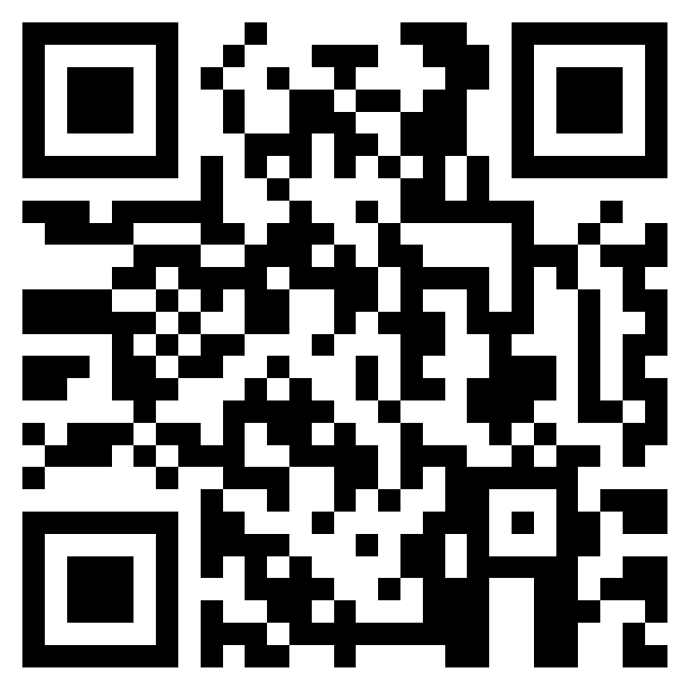
Teacher Feedback
Notes:
Teacher, please complete a brief feedback survey by scanning the QR code or using the link below
https://forms.office.com/r/i9UqyyxzTT

