Slide 1
SAP Ariba Phase-2 Training for Procurement Team
November 21, 2024

Slide 2
Prerequisite
Agenda
1
Welcome & Introductions
2
Create a Contract Workspace – Master Agreement
3
Complete the Contract Workspace Task List
4
Complete the SBE Utilization D-Form
5
Create a Contract Compliance Terms Document
6
Create a Contract Workspace – Sub-Agreement
7
Spend Accumulations from Sub-Agreement to the Parent Agreement
8
Create a Contract Amendment
9
Wrap Up, Q&A

Slide 3
Class Schedule – 2.5 hours – 9am to 11:30am
9:00 AM – Welcome and Introductions
9:05 AM – Create a Contract Workspace – Master Agreement or Bench Agreement
SBE Participation & Percent Tracking D Form
9:30 AM – Complete the Contract Workspace Task List
10:15 AM - Create a Contract Workspace – Sub-Agreement
Novation – Replacing an existing party with a new party
10:45 AM - Create a Contract Compliance Terms Document
Identify the Contract Number that will be used in the approval process
Create the CC Terms Document at the "Commodity" level or at the "Item" level
11:15 AM – Create a Contract Amendment
11:15 – Q&A
11:30 - End of Classroom Session

Slide 4
Quick Vocabulary Lesson
Key Term | Description
P2P core | Ariba interface for power users and the Purchasing Team
CW | Contract Workspace
Master Agreement | Parent Agreement
Sub-Agreement | Child Agreement
Contract Tasks | Outlines the Contract Process in a list
Contract Compliance Terms Document | Links the Contract to Purchase Requisitions / Purchase Orders
SBE Utilization D-Form | A form contained within the Contract Workspace to track spend to SBE Certified Vendors
Contract Amendment | Any change to a contract.

Slide 5
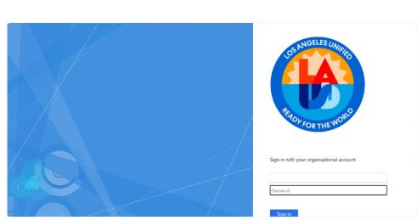
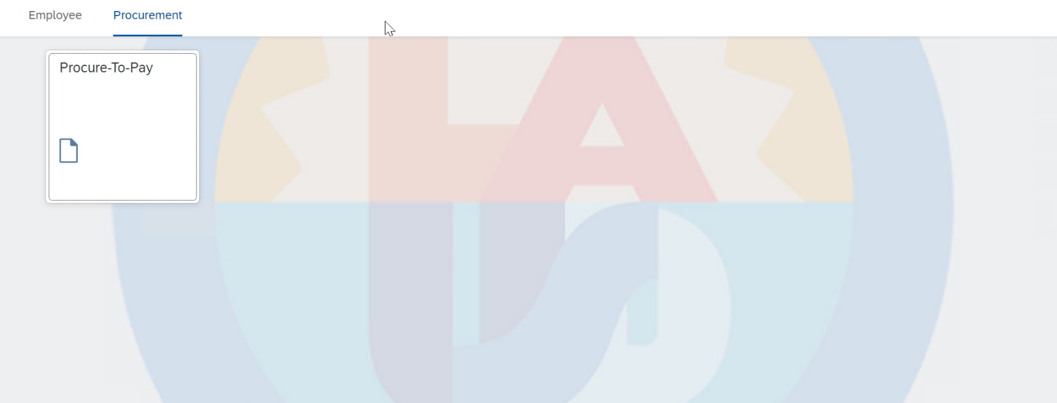
Accessing Ariba P2P Core
Access ESS - https://ess.lausd.net/ and then enter your password.​
Once you have authenticated yourself using ESS, click on the tab titled "Procurement" ​
Next, click the tile titled “Procure-To-Pay" to access Ariba P2P Core.
Ariba uses Single Sign On, so that you do not need to maintain a separate username and password for Ariba. As soon as you click the tile, it will take you directly to the Ariba P2P Core. ​

Slide 6
Create a Contract Workspace

Slide 7
High Level Contract Flow
Create a Contract Workspace
Complete all Required Tasks
Create contract docs, obtain approval, etc.
Publish the Contract Workspace
User requests a contract
Search for an existing contract
Create the Contract Terms Document
Create an Ariba Amendment
Complete all Required Tasks
Create Amendment Docs, obtain approval, etc.
Publish Amendment
User creates a Request for Contract Amendment
Update the Contract Terms Document
Required Change to a Contract
Notes:
If we confirm that no existing contract meets the requester’s needs, we start the contracting process by creating a new contract workspace.

Slide 8
What is a Contract Workspace
Anything else that is relevant to the contract
Contract Documents
Contract Effective and End Dates
Old Versions of Contracts (Redlined Documents)
Approvals
Internal Team Members
Contract Workspace
Amendments
Reminders
Additional Documents
Contract Exhibits
Communications (Letters, emails, faxes, etc.)
Termination Documents
Notes:
You can think of the contract workspace as a folder than contains everything that relates to the contract, including documents, team members, approvals and everything else you see on the screen.

Slide 9
System Training – Instructor will show how to create a Contract Workspace

Slide 10
Create a Contract Workspace (cont’d)
At the top of the P2P Home Dashboard, you will see a list of menu items. The screenshot on the right shows Sourcing, Contracts and Procurement.
This is because we are in the “Parent” realm. To find Requisitions, catalogs, and other buying related menu options users need to switch to the “Child” realm.
Click on the “Site” icon that looks like a globe with an arrow going around.
Next, click on the site titled “LAUSD-C1”. We can identify that this is the “Child” realm by looking for the “–C1” indicating Child realm 1.

Slide 11
Create a Contract Workspace (cont’d)
From the Parent realm, click Create and then Contract Workspace.

Slide 12
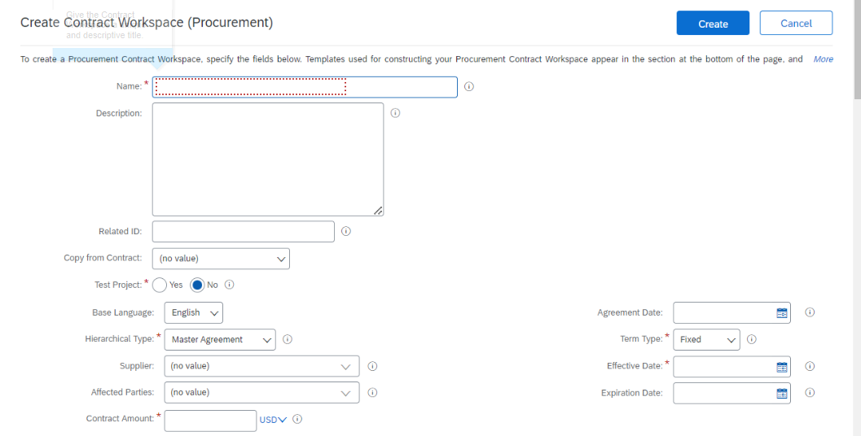
Create a Contract Workspace (cont’d)
The Contract Workspace is a form with optional and required fields. Required fields are marked with a red asterisk.
Name – Give the Contract Workspace a descriptive name.
The naming convention should be consistent with the rest of your team.

Slide 13
Create a Contract Workspace (cont’d)
Copy from Contract is a big time-saver. If there is a contract already created that is similar, you have the option to copy that contract and change the fields that need to be changed.
The only two fields that cannot be changed is “Test Project” and the “Template” that was selected.

Slide 14
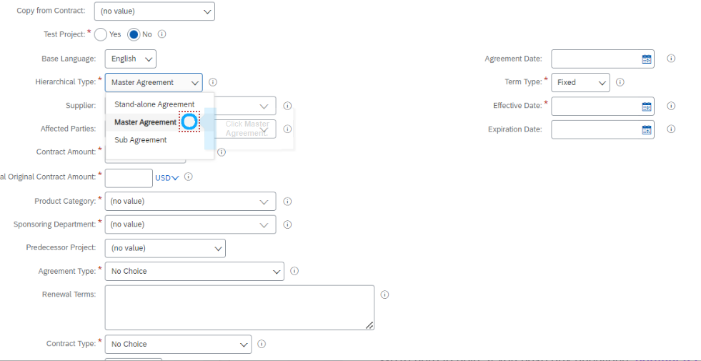
Create a Contract Workspace (cont’d)
In the Hierarchical Type field, there are 3 types of Contracts:
Stand-alone Agreement: Not part of any hierarchy. Can be created independently for contracts that will not have sub agreements.
Master Agreement: Is the top-most contract in a hierarchy. It can have multiple Sub-Agreements.,
Sub-Agreement: Is a contract associated with a parent contract in a hierarchy which is Master-Agreement.
if you are unsure, the safest selection is to choose a Master Agreement. That way if there are more agreements in the future you can add them as sub agreements.

Slide 15
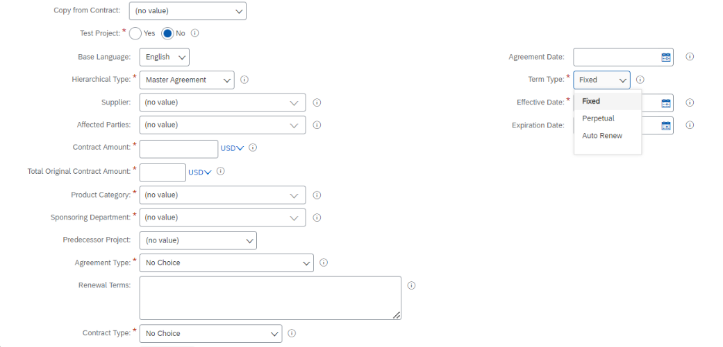
Create a Contract Workspace (cont’d)
Term type has the following options:
Fixed: Has fixed time duration for the contract, which means it would be having a start and end date.
Perpetual: This is evergreen contract. It has start date but no end date.
Auto Renew: This needs a start date, and then define the Renewal interval(in months) and maximum number of intervals.

Slide 16
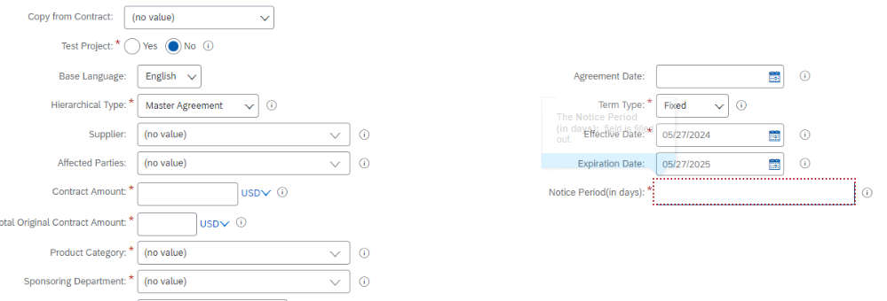
Create a Contract Workspace (cont’d)
Using the calendar icons, we set the effective date and the expiration date of the contract.
Enter days of notice period for this contract. Set the notice period based on how much advance notice is required. For complex contracts, with long negotiation time, you may want to have a more notice such as 60 or 90 days. For a simple contract renewal, you may just need a week or two notice.

Slide 17
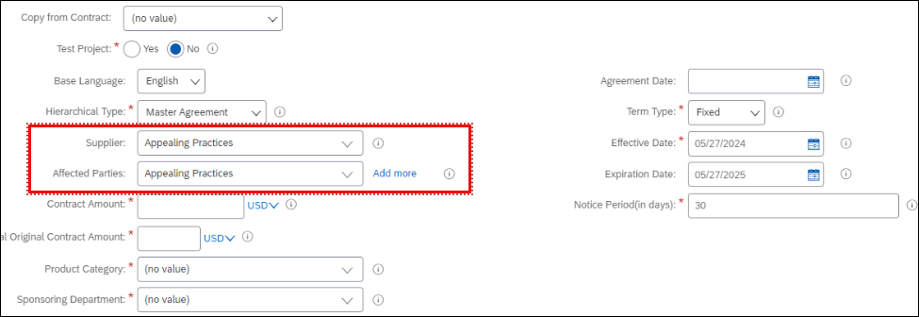
Create a Contract Workspace (cont’d)
Click the downward arrow, and then click search more to find the supplier. If the supplier is not in the system, please follow the LAUSD process to add a new supplier.
Notice how the affected parties have the option to add more suppliers, but the supplier field does not. Each contract workspace will only have one supplier. In the case where you have a contract with a supplier, and that supplier has brought in subcontractors then the sub-contractors would be listed as affected Parties.

Slide 18
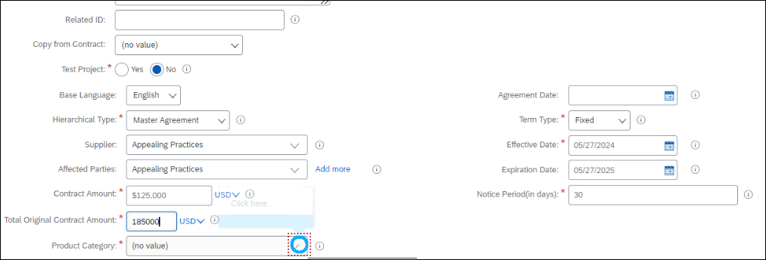
Create a Contract Workspace (cont’d)
The total original amount for contract is the total value, we are expecting to be added as renewal or updates at later stage.
That value should be added here.
The total original amount for contract is the total value, we are expecting to be added as renewal or updates at later stage.

Slide 19
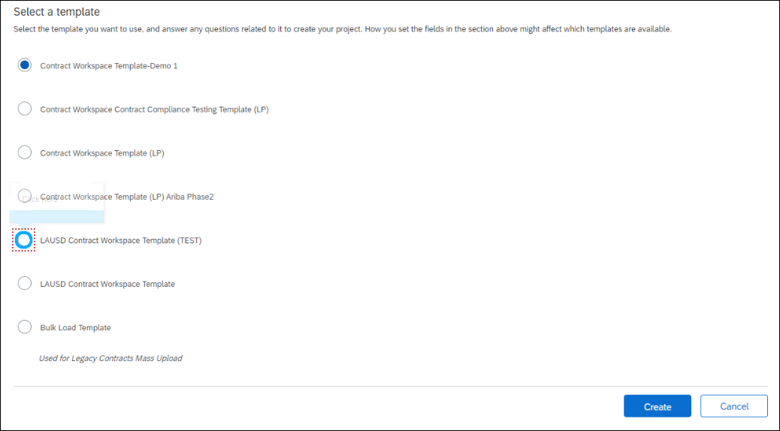
Create a Contract Workspace (cont’d)
Select the relevant template. Please remember that this is the test environment, and the templates will most likely change in Production.
Read the template description and choose the best template for this contract.

Slide 20
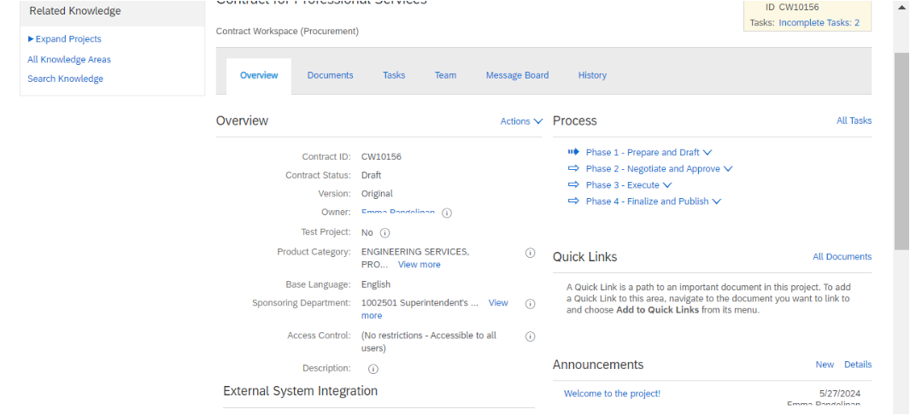
Create a Contract Workspace (cont’d)
The Contract Workspace has been created.

Slide 21
Course Summary
Key Takeaways
Make sure you are in the Parent Realm.
Always use "Contract Workspace (Procurement)."
Complete the Contract Workspace form.
If unsure as to what type of Agreement, choose "Master Agreement."
The "Contract Amount" should be the total contract amount including all items, services, maintenance, across the entire term of the contract.

Slide 22
Knowledge Check
Question
Multiple Choice:
To create a Contract Workspace the user must be in the
c
A – Parent realm
c
B – Child realm
c
C – Either the Parent or the Child realm
c
D – In the Contract realm
Animate to show the correct answer
Notes:
A – Parent Realm (Upstream).

Slide 23
Knowledge Check
Question
True or False:
A Contract Workspace can have more than one supplier. For example, one Contract Workspace to both Dell and Apple for computers
c
True
c
False
Animate to show the correct answer
Notes:
False. One Contract Workspace, one supplier.

Slide 24
Knowledge Check
Question
Multiple Choice:
The Contract Amount field
c
A – Can be left blank if unknown
c
B – Can be zero dollars ($0.00 USD)
c
C – Both A & B
c
D – Neither A or B
Animate to show the correct answer
Notes:
B. Amount can be $0 for reasons such as loaner equipment, non-disclosure agreements, etc.

Slide 25
SBE Participation & Percent Tracking
D Form

Slide 26
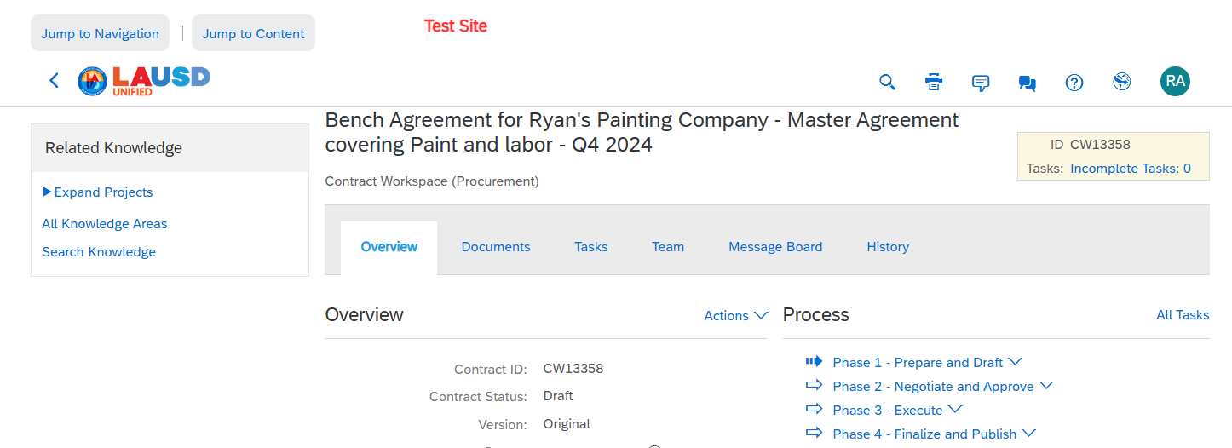
SBE Participation and Tracking
Once you have created the Contract Workspace, we will create a document known as a “D-Form” to track the participation and spend to SBE Certified vendors.
Click the “Documents” Tab.

Slide 27
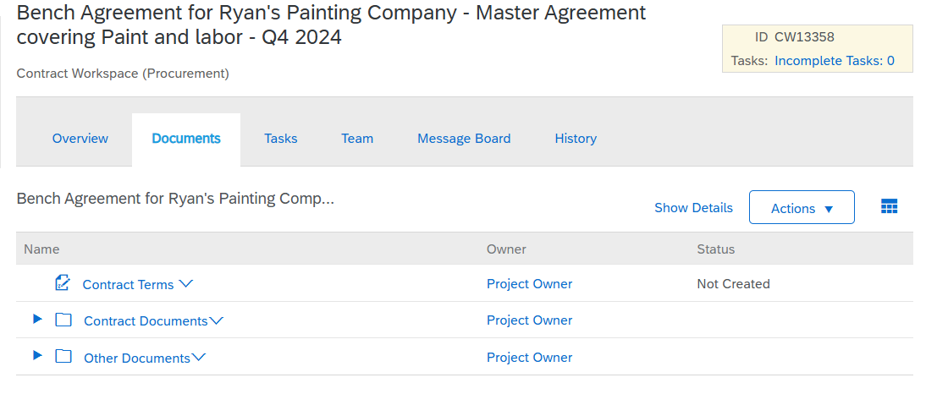
SBE Participation and Tracking
Click the “Actions”

Slide 28
SBE Participation and Tracking
Click “Form”

Slide 29
SBE Participation and Tracking
Click the radio button to the left of the SBE Utilization Data form.
Click Create.

Slide 30
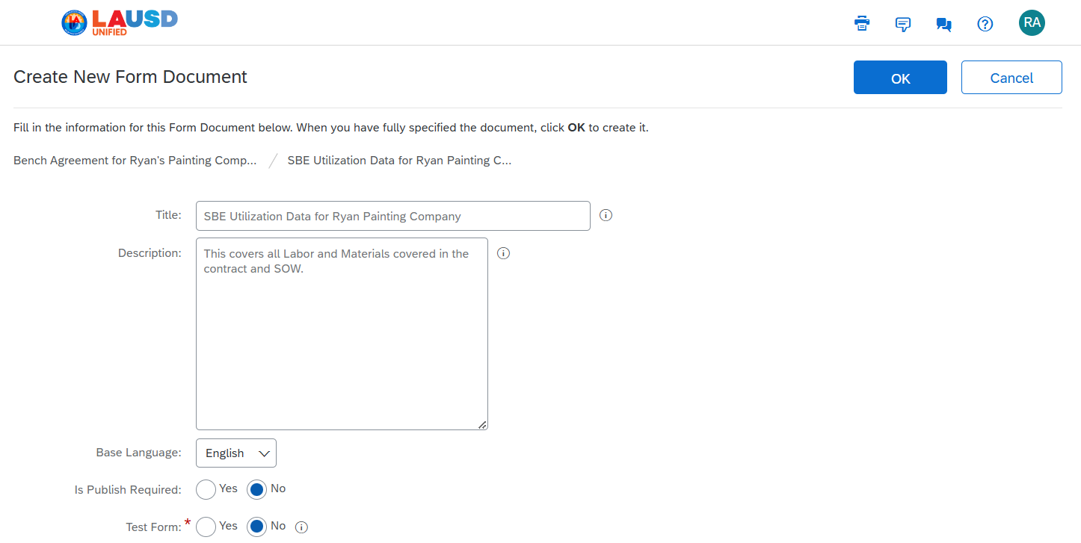
SBE Participation and Tracking
In the “Title” field, give this for a descriptive Name and Description.

Slide 31
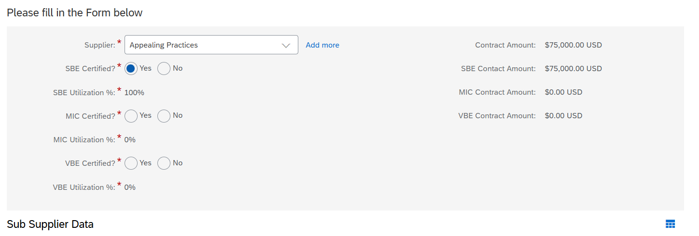
SBE Participation and Tracking
The Contracted Amount will default from the Contract Amount field in the Contract Workspace.
The Supplier will default from the Contract Workspace. Click the “Yes” Radio button to the right of the certification(s) that applies to this supplier. In this example, we will choose yes to SBE Certified.
It is possible that a supplier will have multiple certifications.

Slide 32
SBE Participation and Tracking
If the supplier on the contract is not SBE Certified, but a Sub Supplier is SBE Certified, the Contract Workspace owner has the option to enter those Sub Suppliers here.
Click “Add”, and then search for the supplier’s name. The Sub Supplier must be available in the LAUSD supplier search, or the supplier will need to be added.

Slide 33
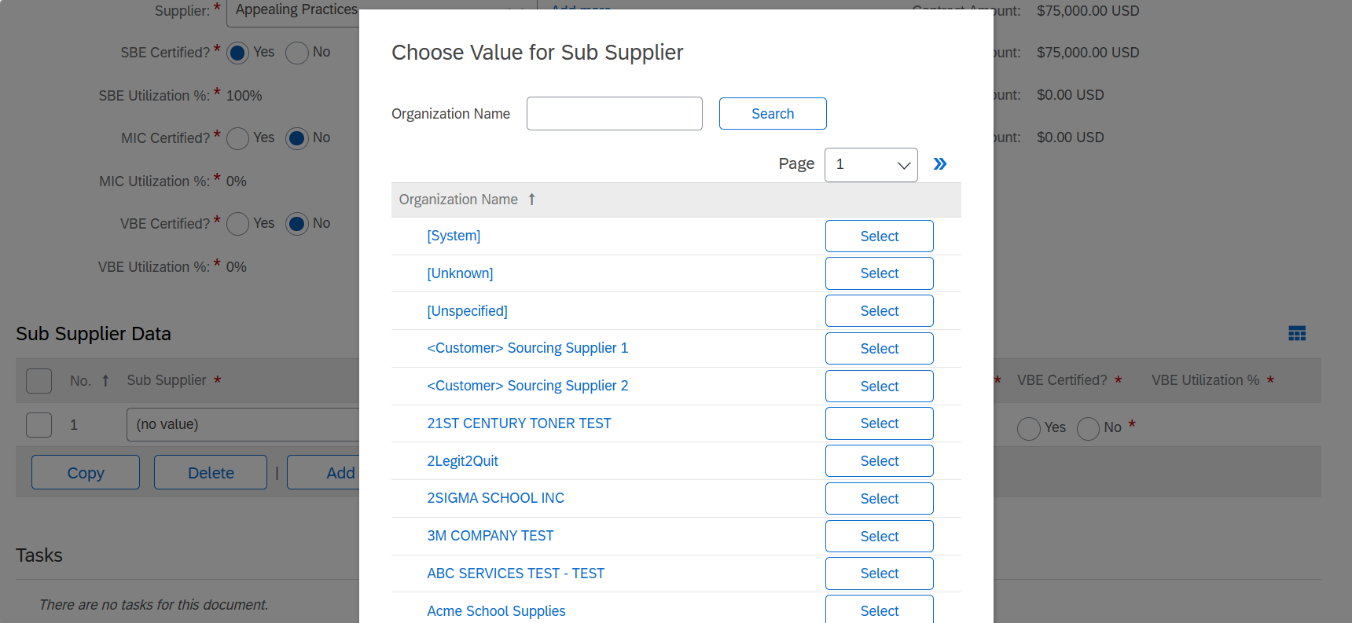
SBE Participation and Tracking
In the Sub Supplier field, enter the supplier's name. Click Search more.

Slide 34
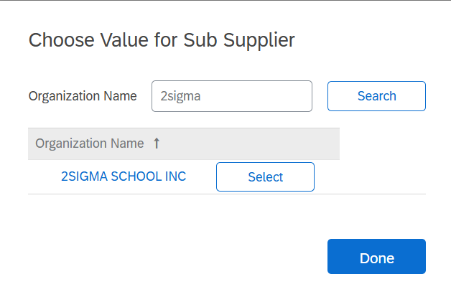
SBE Participation and Tracking
Search for the Sub supplier name. Click “Select” to the right of the supplier’s name.
Choose the certification for this supplier

Slide 35
SBE Participation and Tracking
Enter the Percentage that will be applied as SBE Utilization.
Please note – If the Primary supplier is SBE Certified, 100% of the contract will be applied to the primary supplier. Adding Sub Suppliers and a percentage will be for reference only.
If there are additional Sub suppliers, click Add and follow the same process.

Slide 36
SBE Participation and Tracking
When finished, click Save.

Slide 37
Course Summary
Key Takeaways
The SBE Utilization D-Form can be found on the Contract Workspace Documents Tab, and then click Actions, then Form. Click SBE Utilization Form
A Vendor can have multiple certification types
The SBE D-Form allows tracking against the primary vendor or sub suppliers

Slide 38
Knowledge Check
Question
Multiple Choice:
The SBE Utilization D-Form can be found
c
A – On the CW Overview Tab
c
B – On the CW Documents Tab
c
C – On the CW Task Tab
c
D – On the CW History Tab
Animate to show the correct answer
Notes:
Question 1 is B – On the Documents tab

Slide 39
Knowledge Check
Question
True or False:
The total amount identified on the SBE form can be 100% to the Vendor on the Contract and 25% to a sub-supplier.
c
True
c
False
Animate to show the correct answer
Notes:
Question 3 is False. The total amount identified on the SBE form cannot be more than 100%.

Slide 40
Manage the Contract Workspace Task List

Slide 41
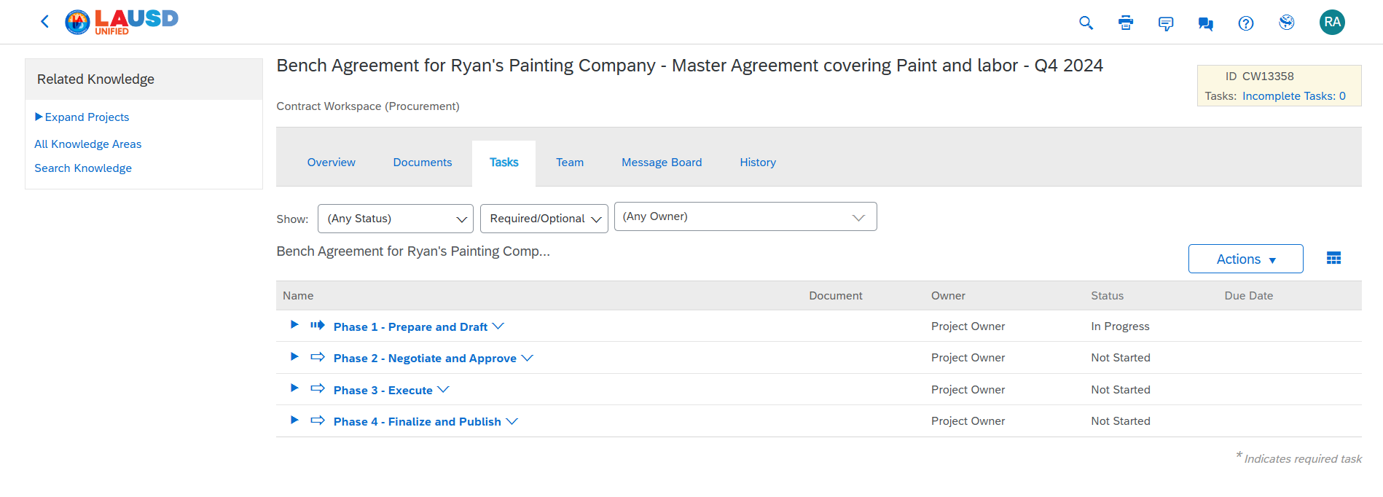
Complete Contract Tasks (cont’d)
The Task list is the LAUSD Contract process. By following the task list, users will be sure that they have completed the contract process correctly.
The task list is made up of 4 sections. Start with phase 1 and complete all of the tasks. Then move to phase 2 and complete all the tasks until all tasks are complete.

Slide 42
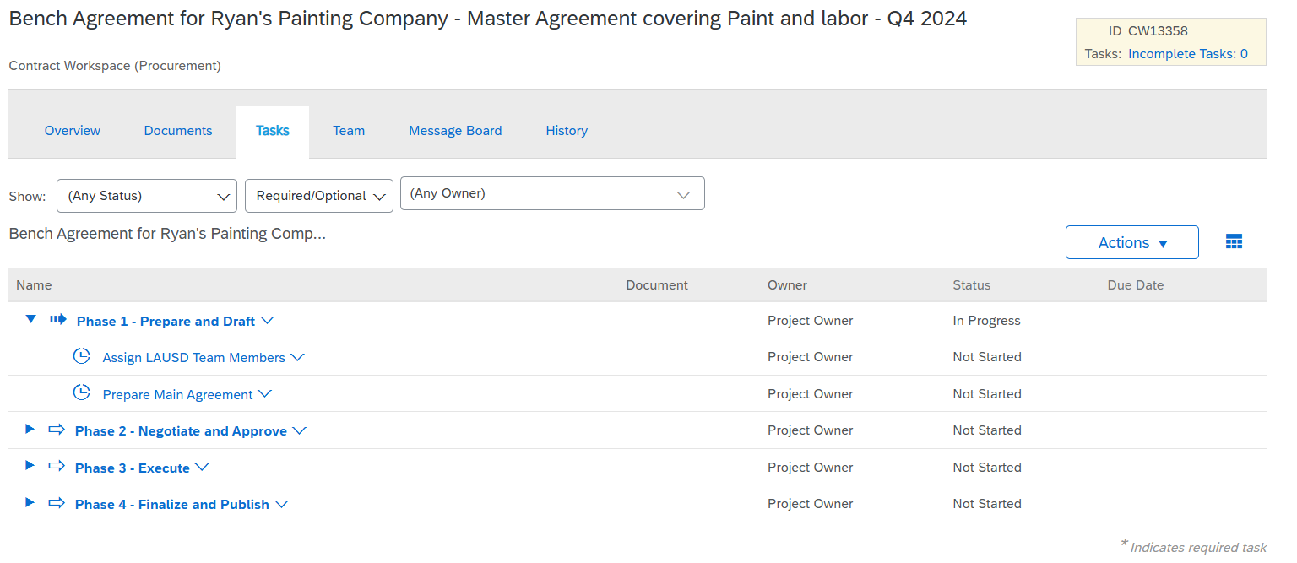
Complete Contract Tasks (cont’d)
Expand each phase by clicking the right facing arrow.

Slide 43
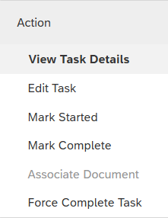
Complete Contract Tasks (cont’d)
Expand each phase by clicking the right facing arrow.
Click on the task name and then click View Task Details

Slide 44
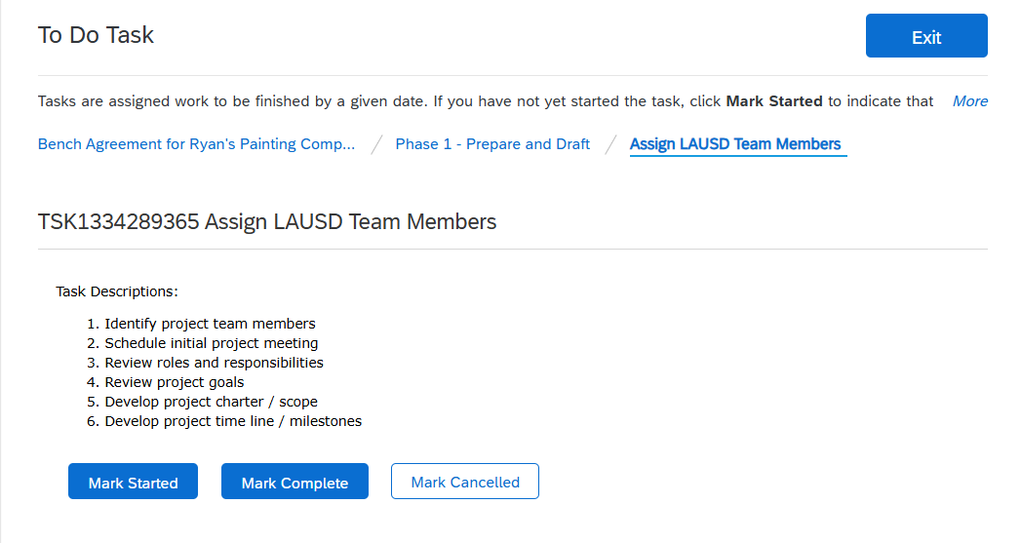
Complete Contract Tasks (cont’d)
A large majority of the tasks on the task list are “To Do” Tasks. To Do tasks all work the same way:
Read the task instructions.
Complete the task
Mark the task complete
Click “Mark Complete”

Slide 45
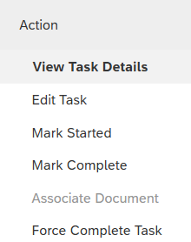
Complete Contract Tasks (cont’d)
The First task is now complete. Move on to the second task and repeat the process.
Click on the name of the 2nd task and then click View Task Details

Slide 46
Complete Contract Tasks (cont’d)
Read the Task Description and complete the task.

Slide 47
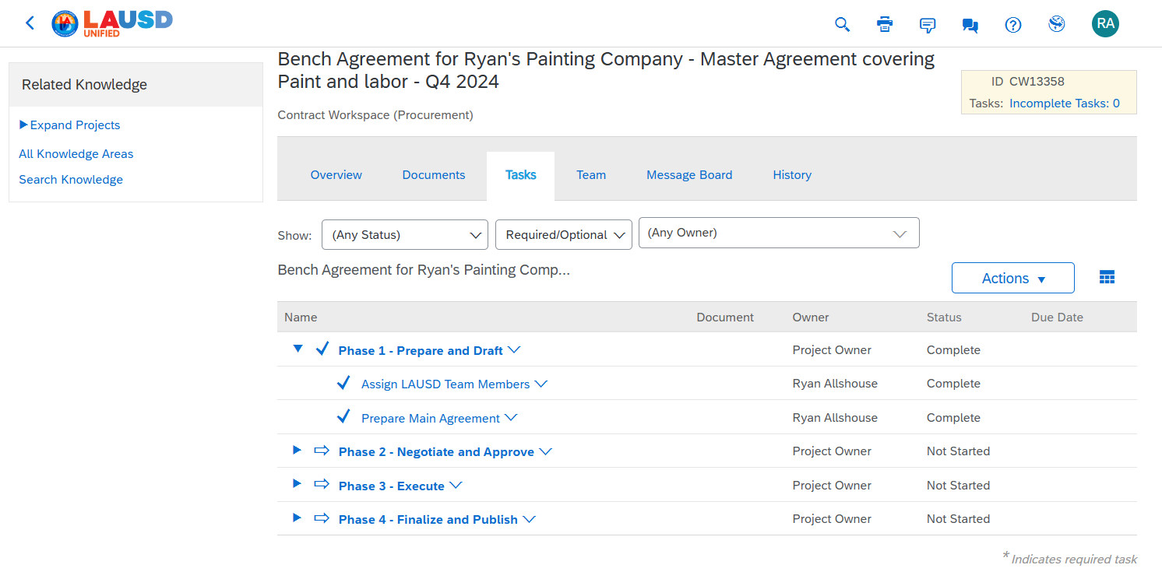
Complete Contract Tasks (cont’d)
Both tasks have been completed and the Phase is complete.

Slide 48
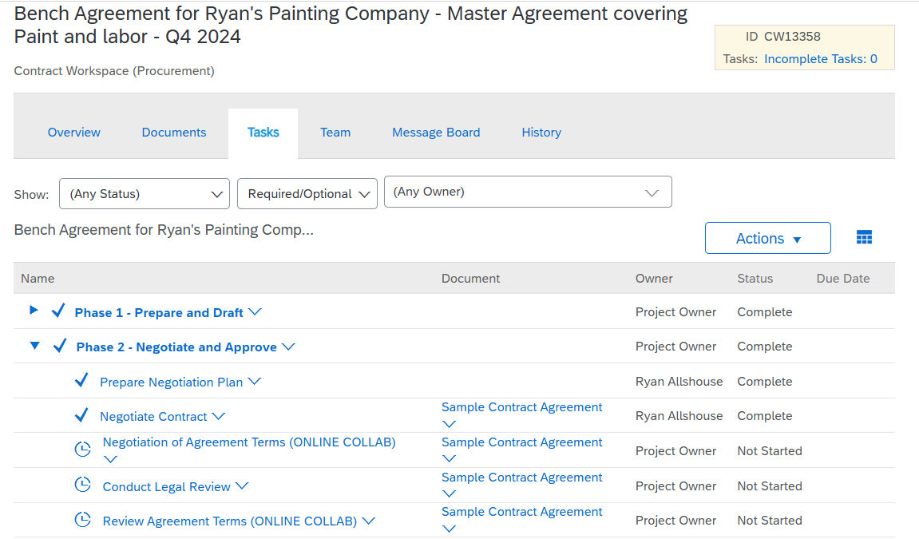
Complete Contract Tasks (cont’d)
In Phase 2 there is a different type of task, called a Negotiation Task.
Click on the task name and then click, View Task Details.

Slide 49
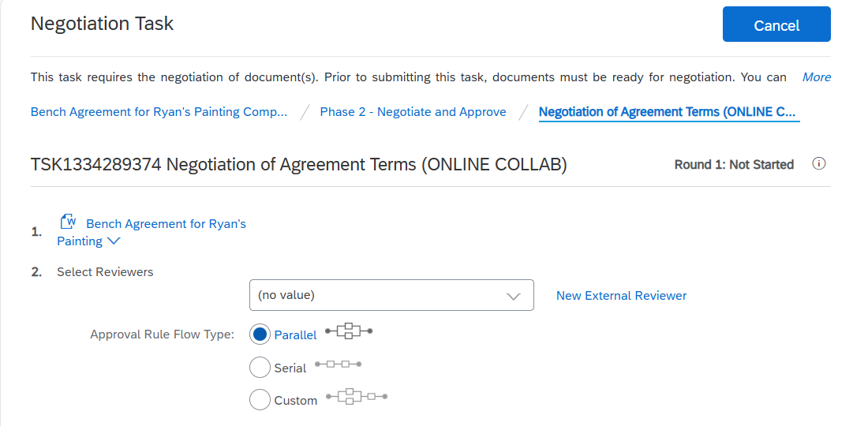
Complete Contract Tasks (cont’d)
We can see the Task Type is a Negotiation Task
Step 1 is to review the agreement between LAUSD and the supplier.

Slide 50
Complete Contract Tasks (cont’d)
Step 2 is to add the contract reviewer(s) from the supplier.
Click “New External Reviewer” to enter the supplier’s email address

Slide 51
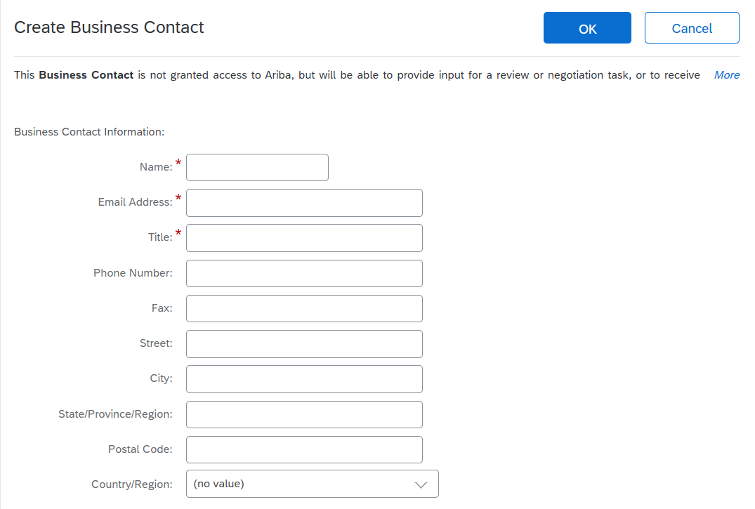
Complete Contract Tasks (cont’d)
Complete the reviewer’s information, and then click OK.

Slide 52
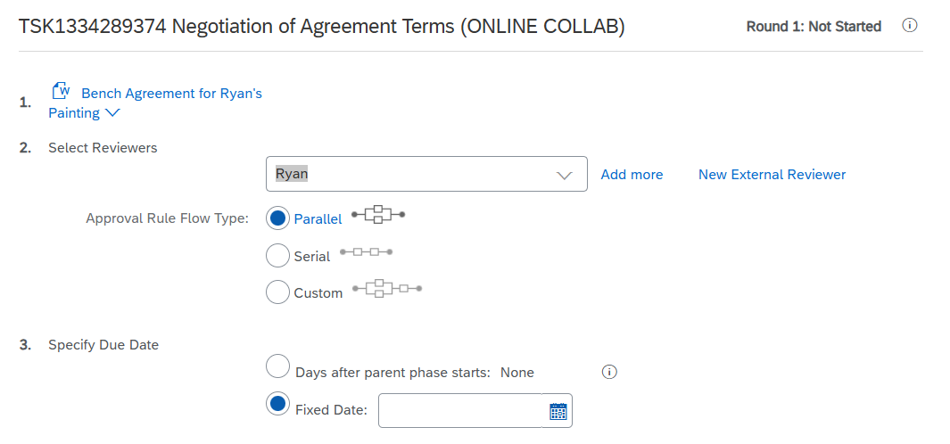
Complete Contract Tasks (cont’d)
You have the option to add additional contract reviewers.
Additionally, you can indicate a due date for the contract review.

Slide 53
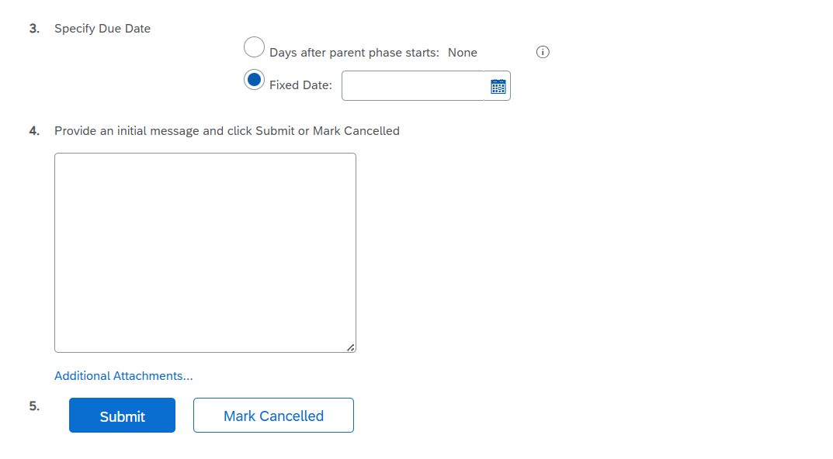
Complete Contract Tasks (cont’d)
Optionally, add comments or attachments.

Slide 54
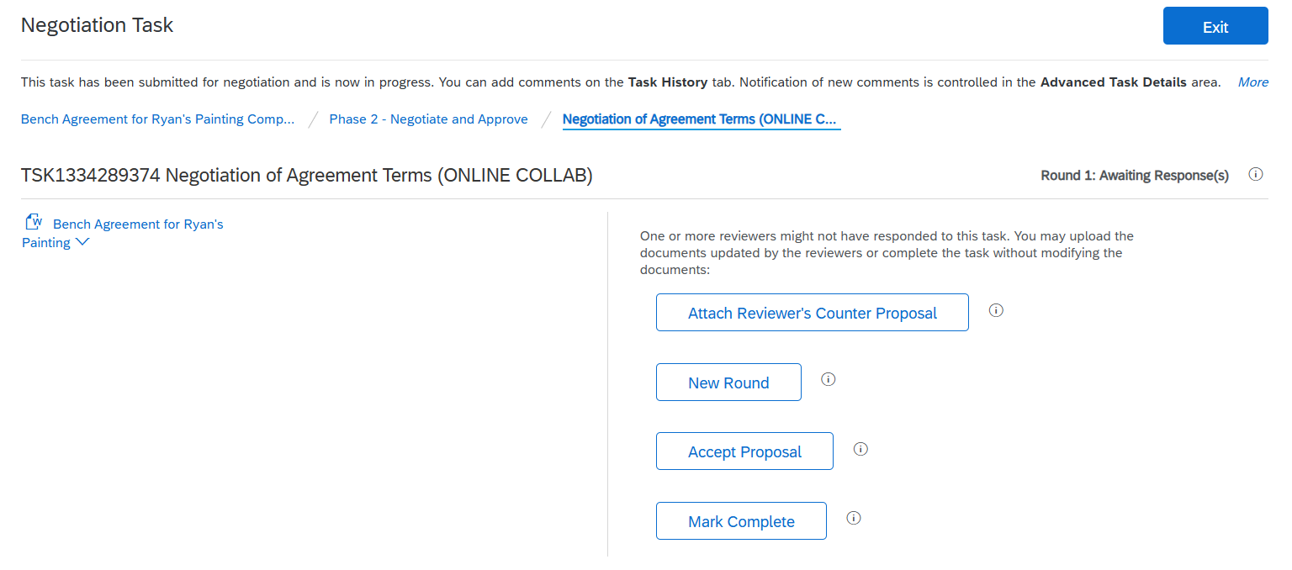
Complete Contract Tasks (cont’d)
If the supplier submits changes to the contract.
If needed, the owner of the contract can start a new round of negotiations
The owner has the option to accept the proposed changes from the supplier
If the supplier accepts the contract as is, mark the task complete

Slide 55
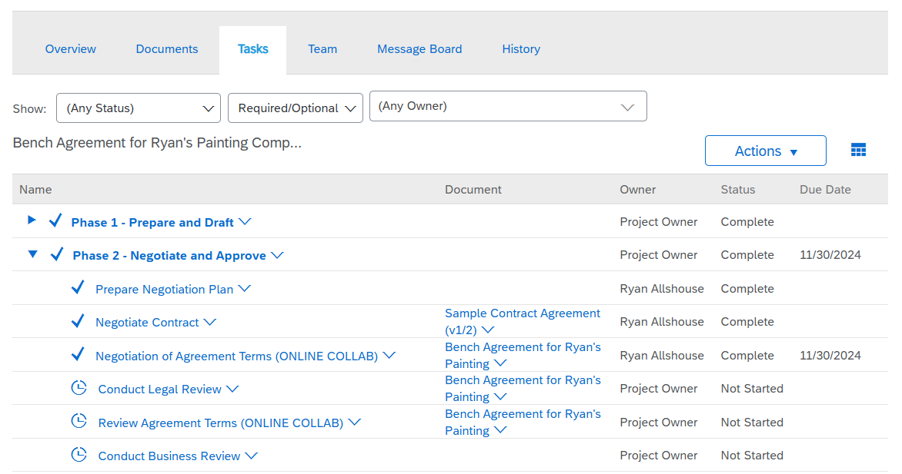
Complete Contract Tasks (cont’d)
When the contract negotiation is finished, and the task has been marked complete move on to the next task.

Slide 56
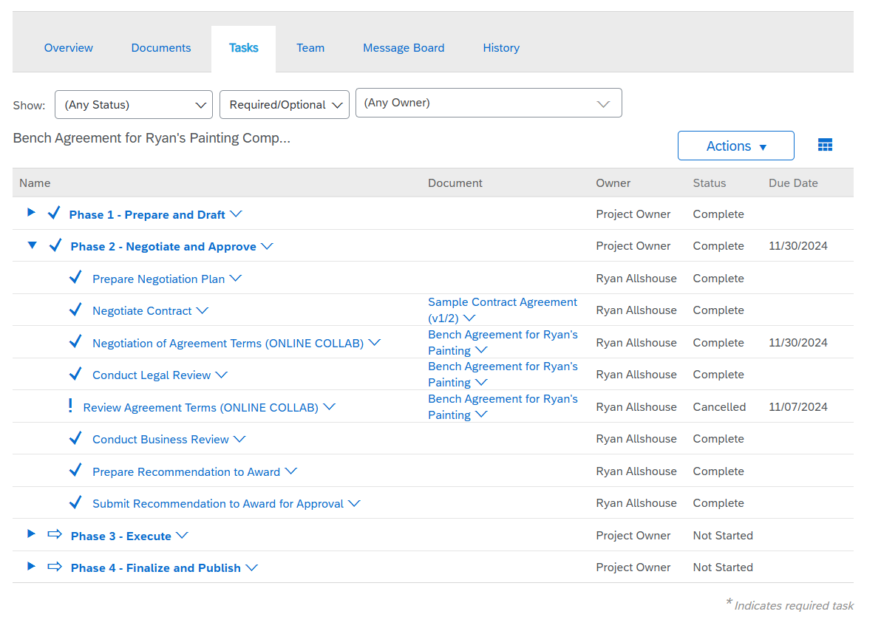
Complete Contract Tasks (cont’d)
Complete the rest of the tasks in phase 2.

Slide 57
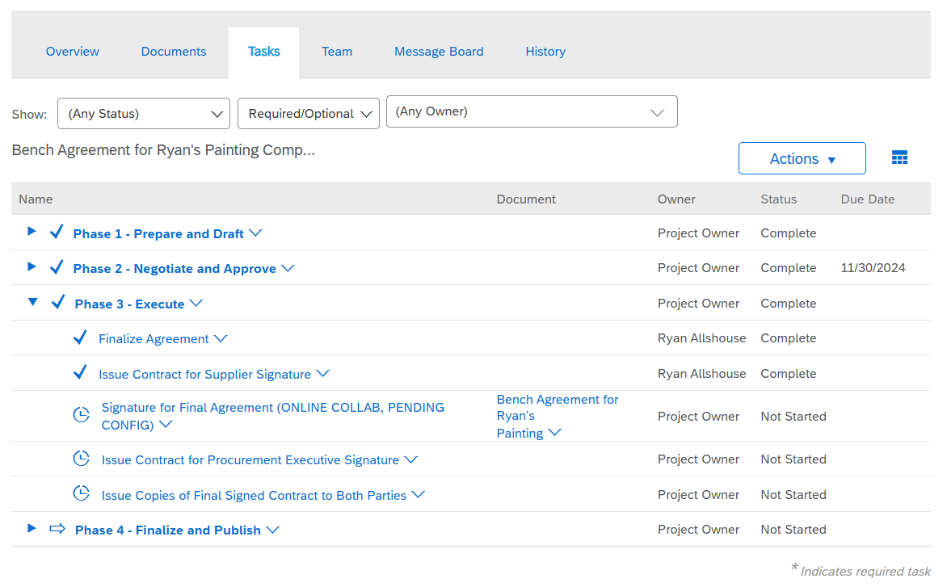
Complete Contract Tasks (cont’d)
In Phase 3, there is a new task type. This task is called a Signature Task. Click on the Task name and click View Task Details

Slide 58
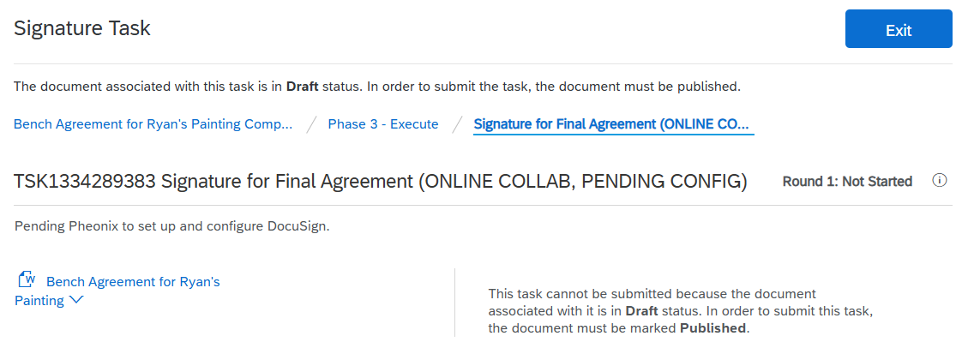
Complete Contract Tasks (cont’d)
The instructions tell us that DocuSign is not currently set up. Until then, contract signature will happen outside of Ariba.
Once the contract is signed, go to the Documents tab on the Contract Workspace.

Slide 59
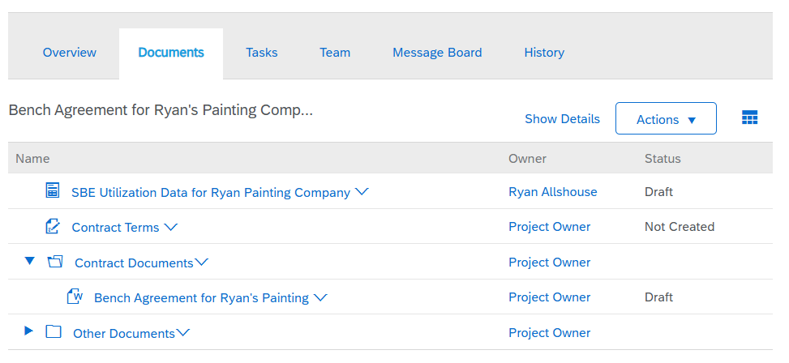
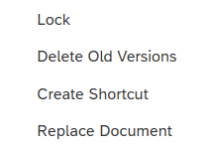
Complete Contract Tasks (cont’d)
Make sure that you are on the Documents tab
Click the current contract agreement, and then click Replace Document.

Slide 60
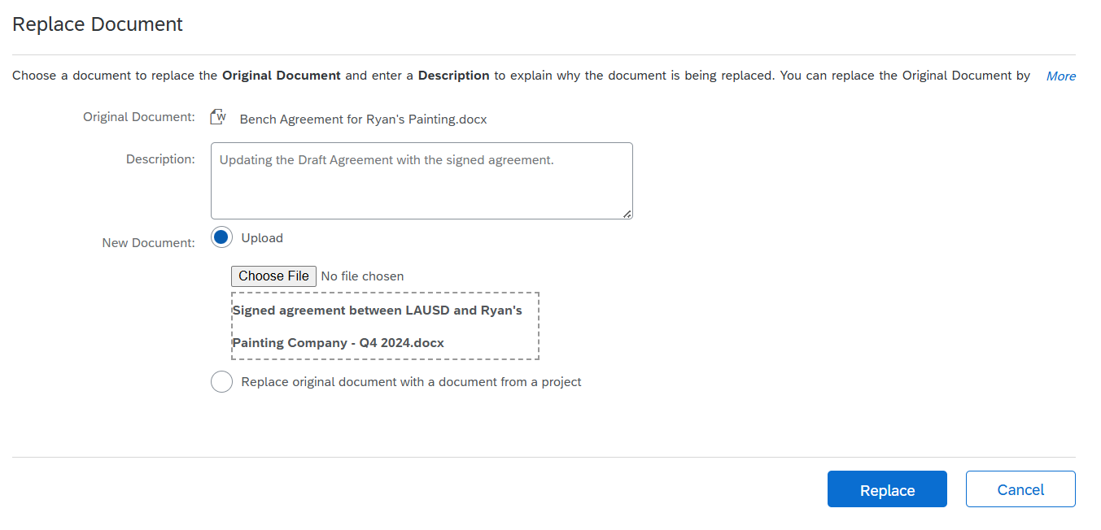
Complete Contract Tasks (cont’d)
Replace the draft document with the signed document. Make sure that the New document is set to “Upload” then drag the signed document to the upload box.
Click Replace

Slide 61
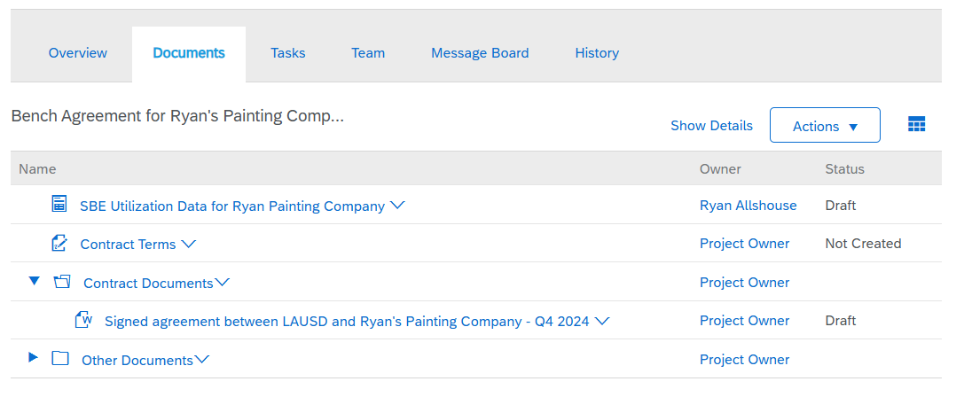
Complete Contract Tasks (cont’d)
The Contract has been replaced with the signed contract. Before we can continue, the contract must be Published.

Slide 62
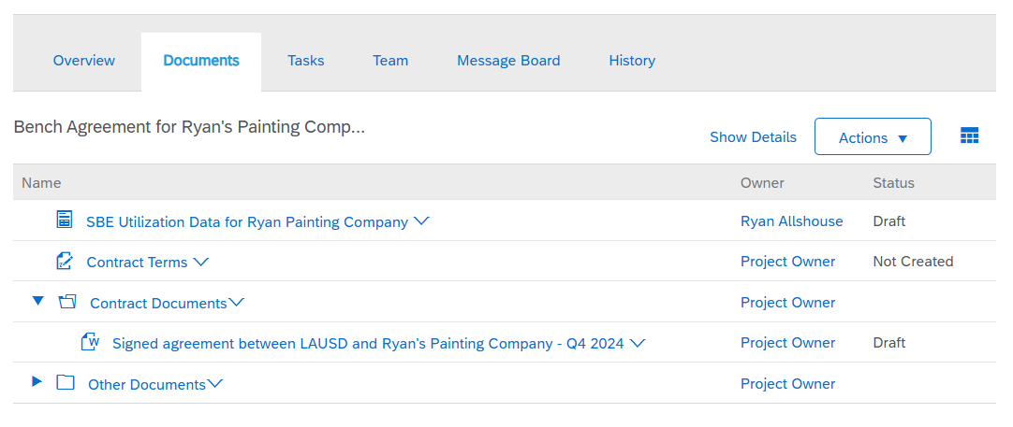
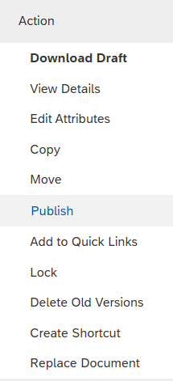
Complete Contract Tasks (cont’d)
Click on the signed agreement, and then click Publish.

Slide 63
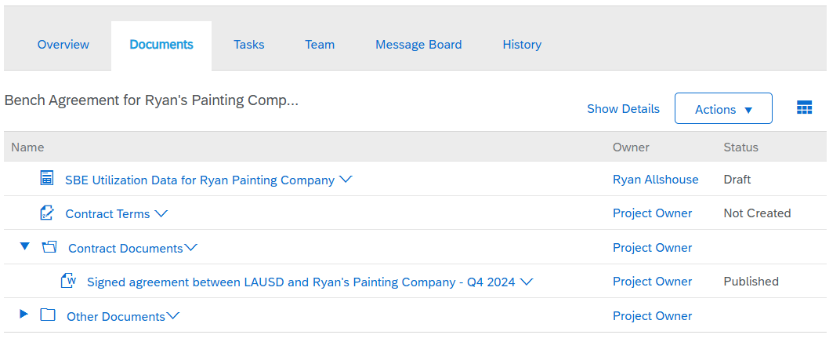
Complete Contract Tasks (cont’d)
The Document is now in Published status.

Slide 64
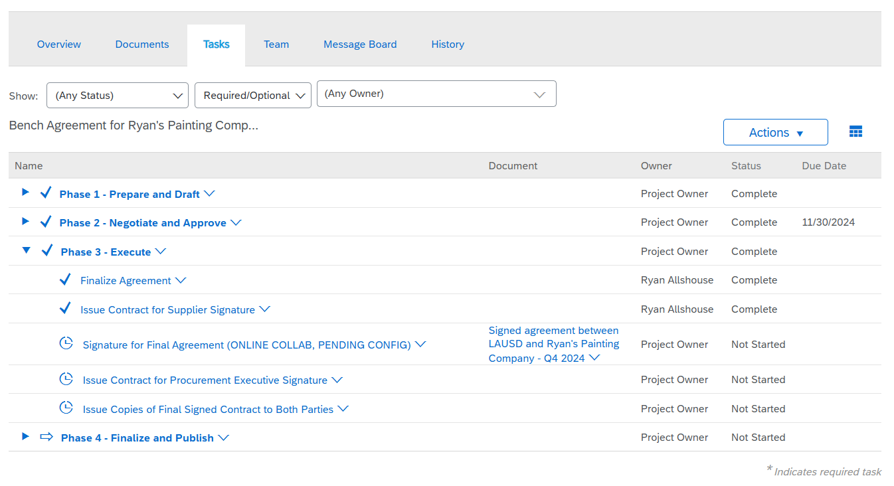
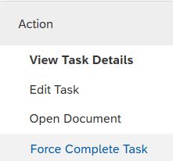
Complete Contract Tasks (cont’d)
Return to the Task tab
We have uploaded the signed agreement in the Documents tab. Since we are not using DocuSign, we must Force Complete Task.

Slide 65
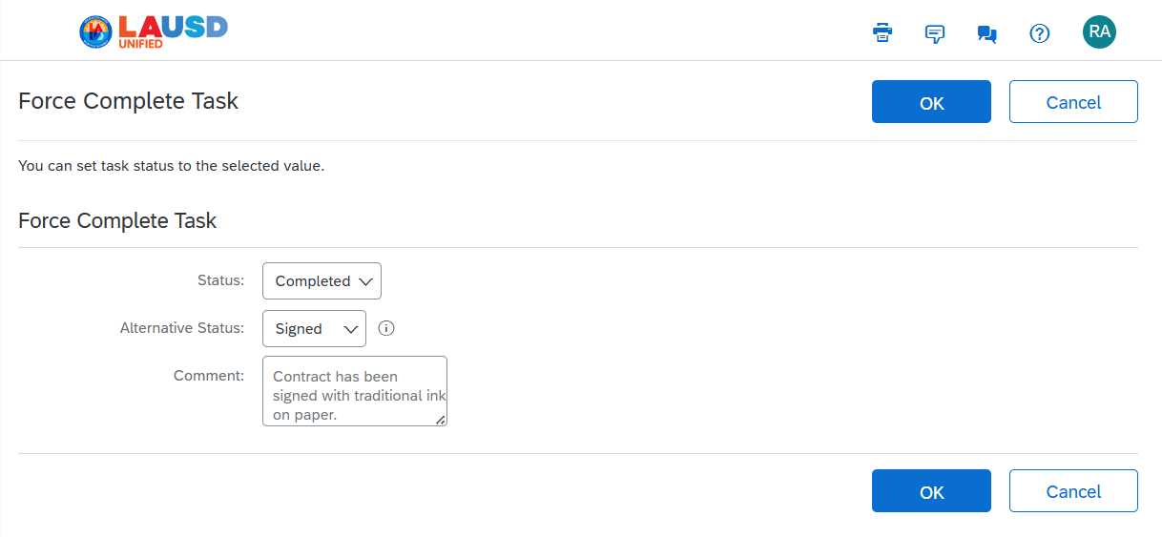
Complete Contract Tasks (cont’d)
Update the fields to show that the signed contract was uploaded to the Contract Workspace.

Slide 66
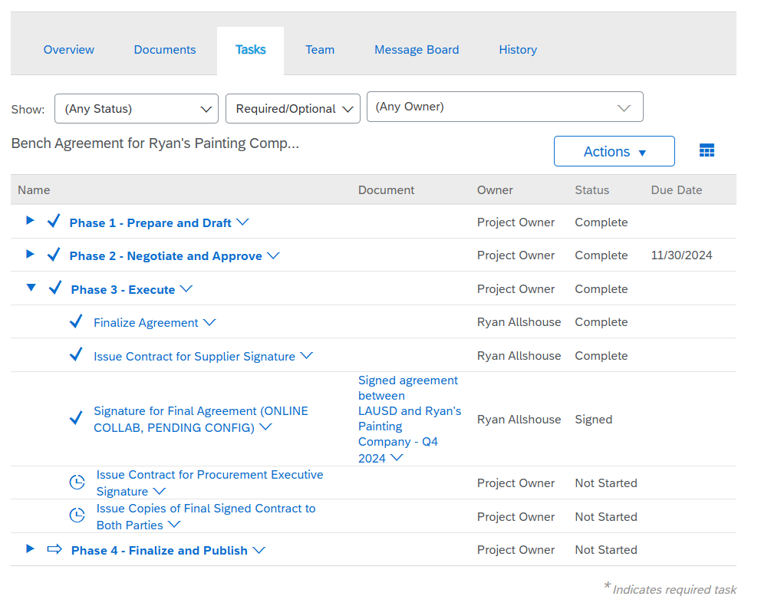
Complete Contract Tasks (cont’d)
The Signature task is now complete
The next two tasks are both To Do tasks. Read the task instructions, and then mark the tasks complete.

Slide 67
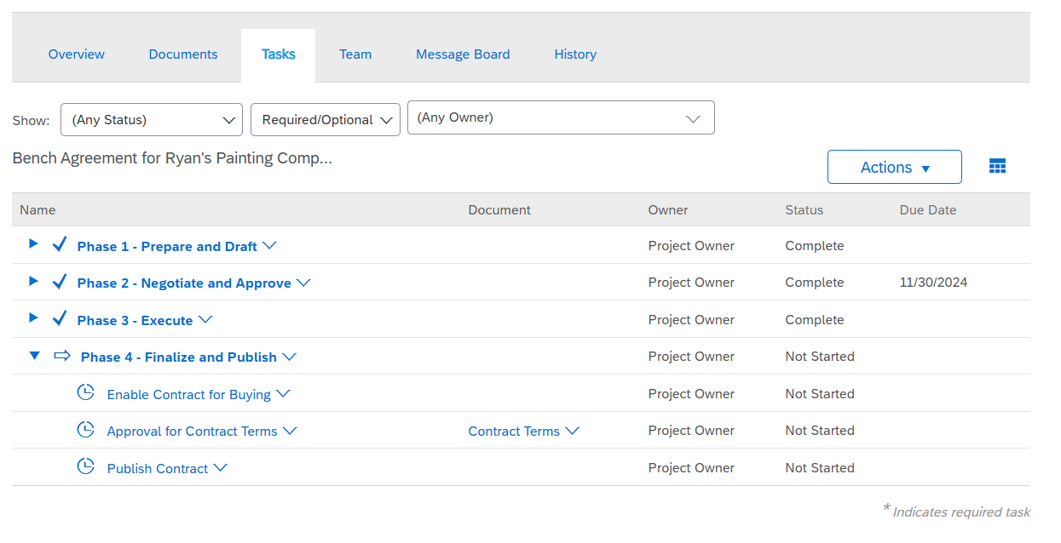
Complete Contract Tasks (cont’d)
Phase 3 is complete, and now we move on to Phase 4

Slide 68
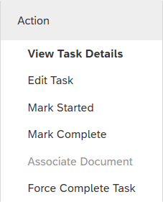
Complete Contract Tasks (cont’d)
Click the task titled “Enable Contract for Buying” and then click View Task Details

Slide 69
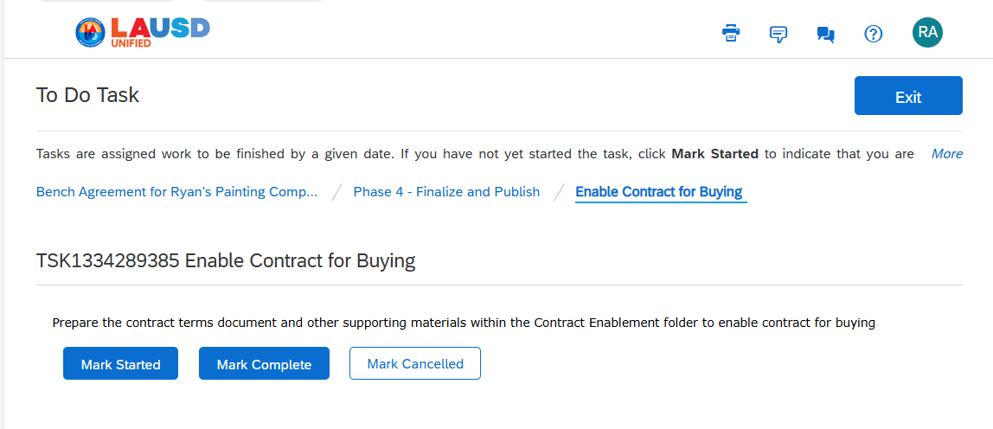
Complete Contract Tasks (cont’d)
Read the task instructions and click Mark Started

Slide 70
Course Summary
Key Takeaways
Make sure that you are on the Contract Workspace Task tab.
There are several task types: To Do Task, Document Task, Negotiation Task, Review Task, and Signature Task,
Start at the first task and click on the task name, and then click "View Task Details.“ Read the task description and complete the task.
Once complete, click on the task name, and then click "Mark Complete."
Repeat this process for all the tasks on the task list.
The Signature Task is not currently set up, bypass the signature task but using the “Replace Document” feature and then cancelling the signature task.

Slide 71
Knowledge Check
Question
True or False:
Best Practice is to start at the top of the task list and complete each task in order from top to bottom.
c
True
c
False
Animate to show the correct answer
Notes:
Answer = True. LAUSD requires a Contract Terms Document to be filled out with each Contract Workspace.

Slide 72
Knowledge Check
Question
Multiple Choice:
The task list for LAUSD is:
c
A – Made up of Required Tasks and Optional Tasks
c
B – Can be completed by the owner of the CW or anyone on the Team Tab.
c
C – Can be To Do Tasks, Negotiation Tasks or Approval Tasks
D – All of the above
Animate to show the correct answer
Notes:
D – All of the above

Slide 73
Knowledge Check
Question
Multiple Choice:
If a task does not apply to your contract
c
A – Just skip the task and move on
c
B – Get written approval from your supervisor to skip the task
c
C – Mark the task Cancelled
D – Mark the task Cancelled and add a note
Animate to show the correct answer
Notes:
D – Mark the task Cancelled and add a note

Slide 74
Contract Compliance
A.K.A Contract Terms Document

Slide 75
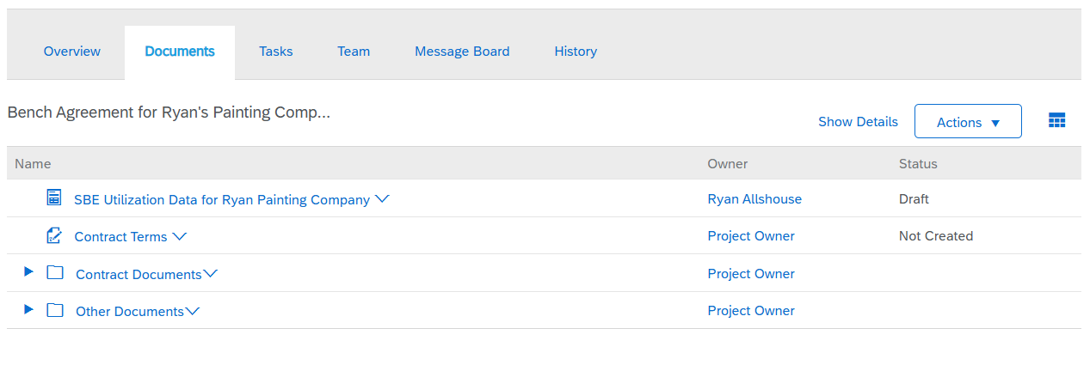
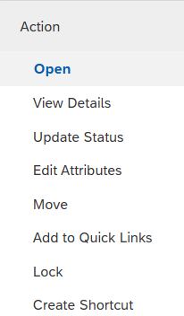
Contract Compliance (or Contract Terms)
Click on the Contract terms document to proceed further.

Slide 76
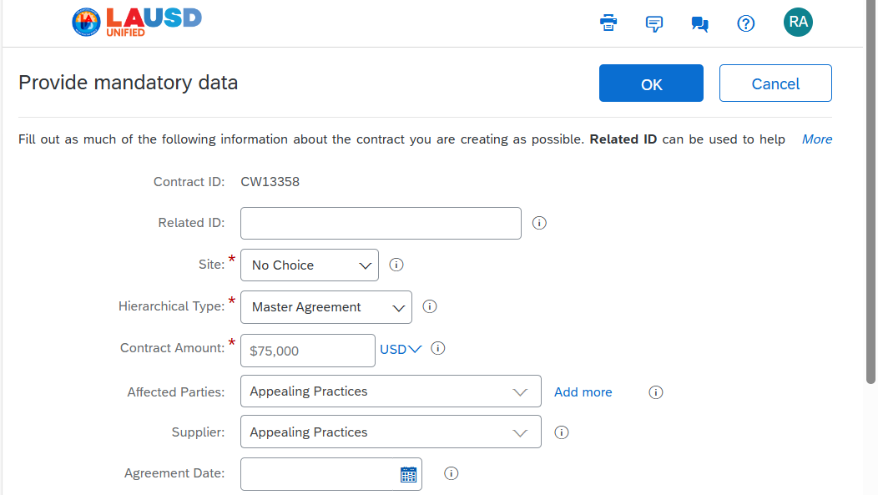
Contract Compliance (cont’d)
The Related ID should not be used due to consistency in reporting.

Slide 77
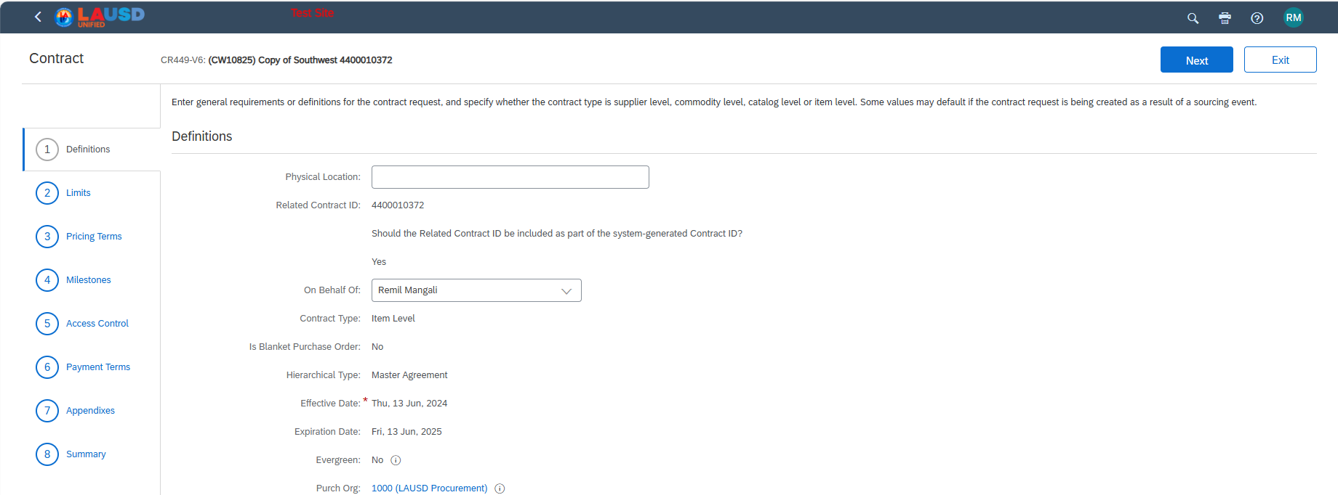
Contract Compliance (cont’d)
The Contract Terms Screen opens.
This is the initial screen. The Contract Terms Document can be easily identified by the 8-step wizard on the left side of the screen.
The definitions page contains the general contract definitions and header level details.

Slide 78
Contract Compliance (cont’d)
Supplier Level – It’s recommended that this is NOT used. All spend to this supplier would be applied to this contract. If a supplier has multiple contracts, it will be difficult to change the referenced contract.
Catalog Level – When a Catalog is created for this supplier, all catalog items will apply to this contract.
Commodity level – If the Supplier and the Commodity matches what was entered on this contract, the PR will apply to this contract.
Item Level – All items must be listed on the contract. When one of these items is selected, it will be applied to this contract

Slide 79
Contract Compliance (cont’d)
Is Blanket Purchase Order: Yes or No.
BPOs can be either release or no-release order contracts. BPOs are issued to one supplier for multiple purchases of specific goods or services for a specific time-period and a predetermined amount that cannot be exceeded. This is not commonly used.
Release Required is typically set to yes. A release is a Purchase Requisition applied to this contract. Once the Requisition is approved, that is the release against this contract.

Slide 80
Contract Compliance (cont’d)
The Limits section defines contract limits. For example, defining the contract minimum and maximum.
Release limits allows the user to define minimum and maximum Purchase Order amounts.
Notice that the Maximum limit is pulling from the Contract Amount.

Slide 81
Contract Compliance (cont’d)
Pricing terms is where we would enter the line items covered in this contract. This will enforce the terms negotiated.

Slide 82
Contract Compliance (cont’d)
Milestones can be defined on this page. For example, you can set a list of conditions that must be met before the supplier can receive payment.

Slide 83
Contract Compliance (cont’d)
Access Control allows you the ability to define which users can create releases against this contract, receive notifications, and edit the Contract Compliance Terms document.

Slide 84
Contract Compliance (cont’d)
Payment terms are defined when creating the contract workspace, but you can set different payment terms for the items defined on the Pricing Terms section.

Slide 85
Contract Compliance (cont’d)
Appendix are additional terms, conditions, or requirements that need to be defined.

Slide 86
Contract Compliance (cont’d)
Summary. Review the settings for this contract terms document. If everything is correct, click Save in the upper right corner.

Slide 87
Contract Compliance (cont’d)
In Phase 4, Click on the Task titled “Enable Contract for Buying”, and then click View Task Details

Slide 88
Contract Compliance (cont’d)
Prepare the Contract terms document means to complete the Contract Compliance document. We have completed the Contract Compliance Terms Document and now we need to mark this task complete.

Slide 89
Contract Compliance (cont’d)
The Contract Terms Document needs to be approved. Access the Approval of Contract Terms, Review and enter the required information, and then submit for approval.

Slide 90
Contract Compliance (cont’d)
Verify that the Contract Terms Document is accurate and complete
Select a due date for the Contract Compliance Terms Document
Enter a comment to the Contract Terms Document approver.
Do NOT click Submit yet. Scroll down

Slide 91
Contract Compliance (cont’d)
Make sure that your Supervisor is listed in the approval flow. If not, the next few slides show how to add an approver

Slide 92
Contract Compliance (cont’d)
Click on the Approval Flow tab
If your Supervisor is not in the approval flow. Click Add Initial Approver

Slide 93
Contract Compliance (cont’d)
Click the downward arrow to search for the approver’s name.
We have selected Purchasing Director 02 as the approver. Please select the appropriate approver for your contract

Slide 94
Contract Compliance (cont’d)
When the approval flow is correct, click Submit.

Slide 95
Course Summary
Key Takeaways
To Access the Contract Compliance Terms document, click on the Documents tab, and then click on the Document titled "Contract Terms."
The best way to verify that you are on the Contract Terms Document is to look for the 8-step wizard on the left size of the screen.
When setting up a Contract Terms Document the most common type is Commodity and Items.
Save the Terms Document and then return to the Task tab to submit the terms document for approval.

Slide 96
Knowledge Check
Question
True or False:
A Contract Compliance Document (a.k.a Contract Terms Document) is mandatory and should be created with each contract.
c
True
c
False
Animate to show the correct answer
Notes:
Answer = True. LAUSD requires a Contract Terms Document to be filled out with each Contract Workspace.

Slide 97
Knowledge Check
Question
Multiple Choice:
When creating a Contract Compliance Document
c
A – Supplier level contract are commonly used
c
B – Supplier level contracts are seldomly used
c
C – It is recommended that Supplier Level Contracts are not used
c
D – There is no such thing as supplier level contracts
Animate to show the correct answer
Notes:
Question 2 The answer is C. Supplier Level Contracts are against company policy and should not be used.

Slide 98
Knowledge Check
Question
True or False:
Each Contract Compliance Document (a.k.a Contract Terms Document) must be approved by Procurement Management.
c
True
c
False
Animate to show the correct answer
Notes:
Answer = True. The CW owner must manually add the Procurement Management as an approver for the Contract Compliance Terms document.

Slide 99
Knowledge Check
Question
Multiple Choice:
c
A – Supplier level contract are commonly used
c
B – Supplier level contracts are seldomly used
c
C – It is recommended that Supplier Level Contracts are not used
c
D – There is no such thing as supplier level contracts
Animate to show the correct answer
Notes:
Question 2 The answer is C. Supplier Level Contracts are against company policy and should not be used.

Slide 100
Publish the Contract Workspace

Slide 101
Contract Compliance (cont’d)
Once the Contract Compliance Terms document has been approved, it’s time to publish the Contract.
Click Publish Contract task and mark it complete.

Slide 102
Contract Compliance (cont’d)
Scroll down to the Contract Attributes section on the Contract Overview tab.
Click Actions, and then click Publish.

Slide 103
Contract Compliance (cont’d)
The Contract Compliance Terms document will open. Review the entire document and then click Submit.

Slide 104
Contract Compliance (cont’d)
The contract is Published, and Requisitions can be applied to this contract.

Slide 105
Course Summary
Key Takeaways
User must complete all required tasks in the Contract Workspace task list before Publishing the contract.
If the Contract effective date is in the future, the status will not change to Published until the start date of the contract
Any changes to the contract will require an Amendment

Slide 106
Knowledge Check
Question
True or False:
The Contract MUST be published to apply Purchase Orders against the Contract.
c
True
c
False
Animate to show the correct answer
Notes:
Answer = True. Users must publish the Contract

Slide 107
Create a Sub-Agreement

Slide 108
Contract Compliance (cont’d)
Create a “Contract Workspace (Procurement).”

Slide 109
Contract Compliance (cont’d)
Complete the Name, Description based on what you learned in the previous module.
In the Hierarchical Type field, click ‘Sub Agreement’

Slide 110
Contract Compliance (cont’d)
Because we selected ‘Sub Agreement’ there is a new field titled ‘Parent Agreement’

Slide 111
Contract Compliance (cont’d)
The Effective and Expiration dates should be within the term dates of the parent agreement.

Slide 112
Contract Compliance (cont’d)
Search for the Parent Agreement
Click Select to the right of the parent agreement

Slide 113
Contract Compliance (cont’d)
Complete the rest of the Contract Workspace form.
Choose the appropriate template

Slide 114
Contract Compliance (cont’d)
The Sub Agreement is completed the same way as a Master Agreement.
Start on the Task tab and compete each task until this Sub Agreement is Published.

Slide 115
Contract Compliance (cont’d)
Notice in the Contract Attributes section of the Contract Workspace Overview tab, it shows the amount of the Master Agreement.

Slide 116
Contract Compliance (cont’d)
We have completed all the tasks up to Phase 4. ‘Enable Contract for Buying’ is the Contract Terms Document.

Slide 117
Contract Compliance (cont’d)
To access the Contract Terms Document, click on the ‘Documents’ tab and open the Contract Terms Document

Slide 118
Contract Compliance (cont’d)
The Contract Type cannot be more specific in the Parent Agreement than the Sub-Agreement.
Parent Agreement
Sub-Agreement

Slide 119
Contract Compliance (cont’d)
Don’t forget to change the ‘Allow change orders against closed contract to ‘Yes’.
If you change the field titled ‘Include Sub agreement Accumulators’ to ‘Yes’ this will include the contract spend to be accumulated from Sub-Agreements to the parent agreement

Slide 120
Contract Compliance (cont’d)
Click Next.

Slide 121
Contract Compliance (cont’d)
Notice that the default Maximum Limit will default from the Master Agreement. Users might need to change the Maximum limit to the contract amount of the Sub-Agreement

Slide 122
Contract Compliance (cont’d)
Complete each step of the 8-step wizard and then click ‘Save’.

Slide 123
Contract Compliance (cont’d)
Be aware that when obtaining approval from the Board of Education for this contract, the contract number to reference would be C932. Drop the ‘R’ when referencing this contract.

Slide 124
Course Summary
Key Takeaways
User must complete the task in the Contract Workspace before Publishing the contract.
When submitting the contract for Board approval, reference the CR number but Drop the R.

Slide 125
Knowledge Check
Question
True or False:
When choosing a Sub-Agreement, the Parent field is a required field.
c
True
c
False
Animate to show the correct answer
Notes:
Answer = True. Users must publish the Contract

Slide 126
Knowledge Check
Question
Multiple Choice:
When submitting the Contract for Board of Education Approval
c
A – Reference the Contract Workspace number (CW)
c
B – Reference the Contract Compliance number (CR)
c
C – Reference the Contract Compliance number but drop the R and Reference the (C) number
c
D – Reference the Purchase Order Number
Animate to show the correct answer
Notes:
Question 2 The answer is C. Supplier Level Contracts are against company policy and should not be used.

Slide 127
Create a Contract Amendment and Update Contract Terms Document

Slide 128
Amend a Contract
Select the desired Contract that requires the amendment.
To amend a contract, the contract must be in “Published” status

Slide 129
Amend a Contract (cont’d)
On the Contract Workspace Overview Tab, scroll down to the Contract Attributes section.
Click Actions, and then click Amend

Slide 130
Amend a Contract (cont’d)
Amendment type is typically “Amendment” type.
Renewal is to update the Term Dates on the Contract.
Amendment allows you to change all contract fields with very few exceptions
Administrative allows you to change high level items such as the contract title, add team members, etc. Very restrictive
Termination is used to terminate a contract. For example, if a supplier can no longer live up to the agreement.
Please make sure to update the Contract Amendment Reason comment as indicated.
Then, click Ok.

Slide 131
Amend a Contract (cont’d)
For example, if you want to add money to the existing contract, locate the Contract Amount field in the Contract Attributes section of the Overview Tab.
Click Actions, and then Edit Attributes

Slide 132
Amend a Contract (cont’d)
In addition to adjusting the price, you have the option to modify other contract attributes.

Slide 133
Amend a Contract (cont’d)
Under the documents tab, open contract terms by clicking on the down arrow as shown.

Slide 134
Update the Contract Terms Document
Upon clicking Open, the system brings you to the contract compliance term document associated with the contract workspace.
Please Note: Since this training module covers only a limited amendment process, we strongly advise reviewing the Ariba training simulation on creating the contract compliance document before proceeding to update it.

Slide 135
Update the Contract Terms Document (cont’d)
Within the Pricing Term section, you'll observe the items already included in the contract. Here, you can modify the item details as needed.
In this instance, let's introduce an additional item to support the price adjustment in the contract. Click on Add items as indicated.

Slide 136
Update the Contract Terms Document (cont’d)
After clicking Done, the new line item will be promptly updated among the materials and services listed under the pricing terms section.

Slide 137
Update the Contract Terms Document (cont’d)
Now, click Save as indicated to save the contract compliance document.

Slide 138
Update the Contract Terms Document (cont’d)
Make sure that you are on the Overview tab of the contract workspace.
Scroll down to the Contract Attributes section, and then click Actions
Next, Click Publish to publish the contract amendment.

Slide 139
Update the Contract Terms Document (cont’d)
Upon approval, the contract will be updated with the contract status as "Published" along with the new version as shown on the screen.

Slide 140
Course Summary
Key Takeaways
An Amendment is ANY change to a contract. e.g. Adding money, extending the term dates, canceling a contract, closing a contract, making corrections to the contract language, etc.
To Amend a Contract, access the Contract and make sure that you are on the contract Overview tab. Scroll down to the Contract Attributes section and click Actions. Next, click Amend.
Choose the Amendment type. The most common is Amendment.
Using the Action buttons, update or edit the required fields.
Once finished, return to the Contract Attributes section and click "Publish."

Slide 141
Contract Migration
All the migrated contracts from SRM will be a 10-digit number series that starts with “44XXXXXXXX”
Since Ariba Contract Workspace only supports a single contract type, any migrated contracts from SRM that include both commodity and item-level contract type associated in one contract will be split into two separate contract IDs in Ariba. These will retain the same 10-digit numbers and will be appended with "CC" for commodity-based contracts and "IT" for item-based contracts.

Slide 142
Knowledge Check
Question
Multiple Choice:
To create a Contract Amendment, the status of the Contract Workspace must be in:
c
A – Draft Status
c
B – Pending Status
c
C – Publishing Status
D – Published Status
Animate to show the correct answer
Notes:
Answer = D – Published Status.

Slide 143
Knowledge Check
Question
Multiple Choice:
The most common contract amendment type is:
c
A – Renewal Amendment
c
B – Amendment Amendment
c
C – Administrative Amendment
c
D – Termination Amendment
Animate to show the correct answer
Notes:
Answer = B – Amendment Amendment opens the workspace in full edit mode and allows users to edit MOST of the fields.

Slide 144
Knowledge Check
Question
Multiple Choice:
When Amending a Contract
c
A – Users can also update the Contract Compliance Terms Document
c
B – Users should obtain all necessary approvals
c
C – Users can add additional Documents to the Contract Workspace
D – All of the above
Animate to show the correct answer
Notes:
Answer = D – All of the above

Slide 145
Knowledge Check
Question
Multiple Choice:
One field that you cannot change with an Amendment is:
c
A – The Contract Owner (LAUSD Purchasing person that created the Contract)
c
B – The Vendor Payment Terms
c
C – The Supplier
D – The Contract Expiration date
Animate to show the correct answer
Notes:
Answer = D – All of the above

Slide 146
Novation
If a Parent Company on a Master Agreement is acquired by another company

Slide 147
Acquisition of a Parent Company
Original hierarchy
Updated hierarchy
Parent Company
Appealing Practices
News
Appealing Practices sold to
Namaste Wellness Enterprises
Parent Company
Appealing Practices
Child Company
Namaste Wellness

Slide 148
Thank you
End of Training
Notes:
We will randomly solicit feedback from learners focusing on these, and other key topic questions.

