Slide 1


Dr. Jesus Renteria
Coordinator of Policy, Research, and Development
Data Privacy, Analysis and Reporting (DPAR)
Office of Data and Accountability (ODA)
Notes:
Hello Everyone, my name is Dr. Jesus Renteria and I am part of the Data Privacy, Analysis and Reporting Branch under ODA. Thank you for having me.

Slide 2

School Experience Survey – Background
The School Experience Survey is an annual survey administered in the Spring to all schools. Survey results provide schools with very important feedback from teachers, staff, students and parents.

Slide 3
School Experience Survey – Background
Importance of Survey Results
Informative – Let’s families, students, and staff know what they are doing well and what they can improve on.
State Accountability – The District is required by the State to administer a “Local Climate Survey” annually and to report results.
LAUSD Strategic Plan – Report progress toward the District 2026 Goals

Slide 4

School Experience Survey
School Experience
Survey will be
administered on:
February 12th to
March 22nd, 2024
Notes:
The first update I wanted to share is that school experience survey will now be administered in the spring. The tentative date is set for February 12th to March 22nd, 2024. Please help spread the word to your school community members and remember to save the date and prepare accordingly.

Slide 5
School Experience Survey - Agenda
DPAR team and services
Overview of the New School Experience Survey Webpage
SES Results – Overview and Walkthrough
LAUSD 2026 Strategic Goals
Strategies and tools to help meet our goals

Slide 6
School Experience Survey - Agenda
DPAR team and services
Overview of the New School Experience Survey Webpage
SES Results – Overview and Walkthrough
LAUSD 2026 Strategic Goals
Strategies and tools to help meet our goals

Slide 7
School Experience Survey Team
Our team has grown…
Dr. Kevon Tucker-Seeley - Director of DPAR
Dr. Jesus Renteria - Coordinator of Policy, Research, and Development
Paolo Tandoc – Strategic Data Analyst
Declan Chin - Data Analyst
Additional Support
Rakesh Kumar – Administrative Coordinator
3 Data Analysts
2 Data Coordinators

Slide 8
School Experience Survey – Support and Services
What we do
SES Logistics
District/School Collaboration and Support
Distribute
Collect
Analyze
Resources
Services
Notes:
We provided a variety of different services and support to the district and schools, but one that stands out is our involvement in the School Experience Survey. Our School Experience Survey Team is responsible for distributing, collecting, and analyzing the School experience survey data. We recognize that you and your team members at your school play a vital part in the SES logistics. We would not have the data without your continuous support and dedication to recruit participants. This is why we make great efforts to collaborate with district and school partners by providing them the support, resources, and services they need to help students, parents, and staff participate in the school experience survey.

Slide 9
School Experience Survey – Support and Services
SES Online Resource Toolkit for Schools
    Supporting Documents
    Recruitment and participation strategies
Support
    Timely email responses and weekly updates
SES Results/Information
    More transparent and accessible
Notes:
Speaker: Text
Time: XX minutes
Purpose:
Text
Notes:
Text
Facilitator Moves:
Text

Slide 10
School Experience Survey - Agenda
DPAR team and services
Overview of the New School Experience Survey Webpage
SES Results – Overview and Walkthrough
LAUSD 2026 Strategic Goals
Strategies and tools to help meet our goals

Slide 11


School Experience Survey Team
New SES Webpage
Click Here for
Webpage Link
Notes:
Speaker: Text
Time: XX minutes
Purpose:
Text
Notes:
Text
Facilitator Moves:
Text

Slide 12
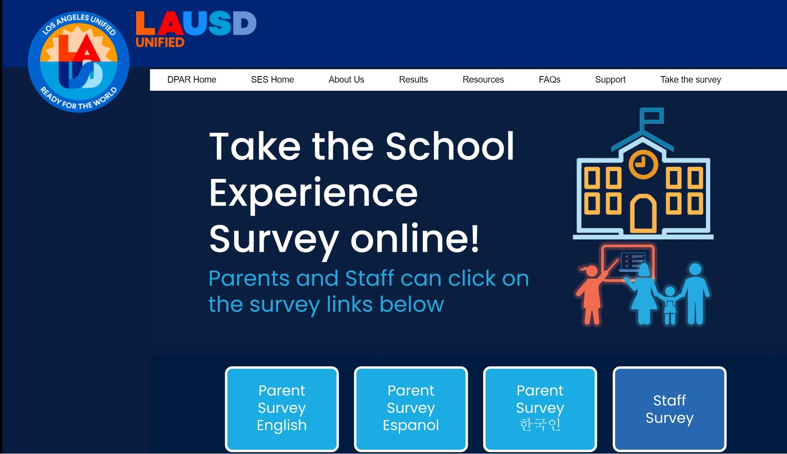
School Experience Survey Team
For Parents and
Staff, it is easier
to find and take
the survey
Notes:
Speaker: Text Add paper Survey
Time: XX minutes
Purpose:
Text
Notes:
Text
Facilitator Moves:
Text

Slide 13
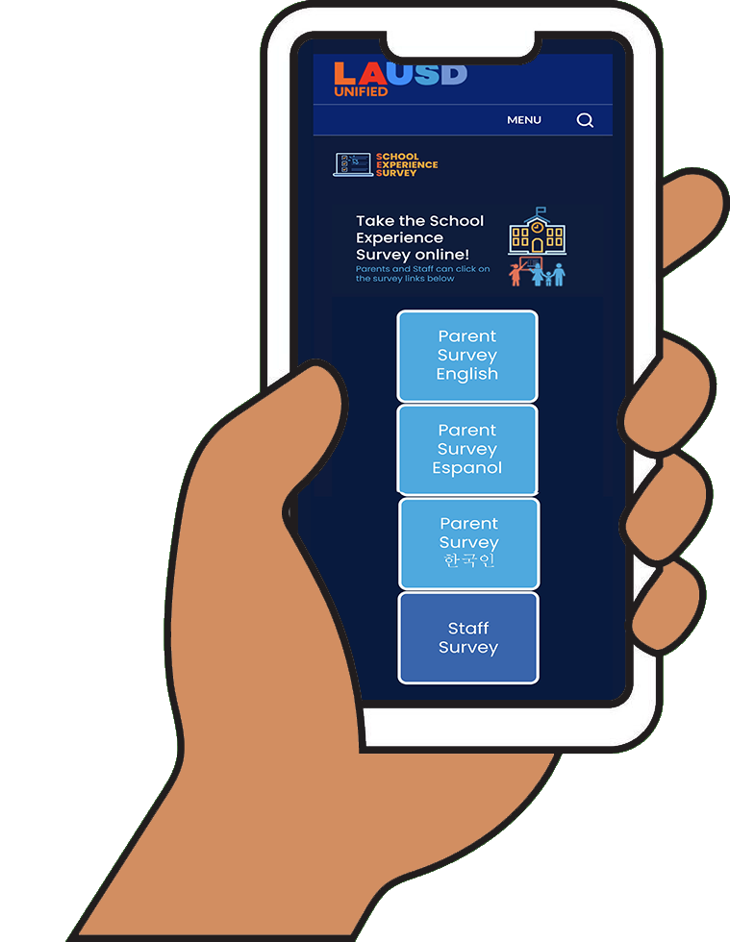
School Experience Survey Team
Smartphone Friendly
Notes:
Speaker: Text
Time: XX minutes
Purpose:
Text
Notes:
Text
Facilitator Moves:
Text

Slide 14

School Experience Survey Team
Parent SES: Paper-Based Survey
Option Update
Limited amount of paper-based Parent SES will be sent out to each school
Highly encouraging parents to take survey online
Notes:
Speaker: Text
Time: XX minutes
Purpose:
Text
Notes:
Text
Facilitator Moves:
Text

Slide 15
School Experience Survey - Agenda
DPAR team and services
Overview of the New School Experience Survey Webpage
SES Results – Overview and Walkthrough
LAUSD 2026 Strategic Goals
Strategies and tools to help meet our goals

Slide 16
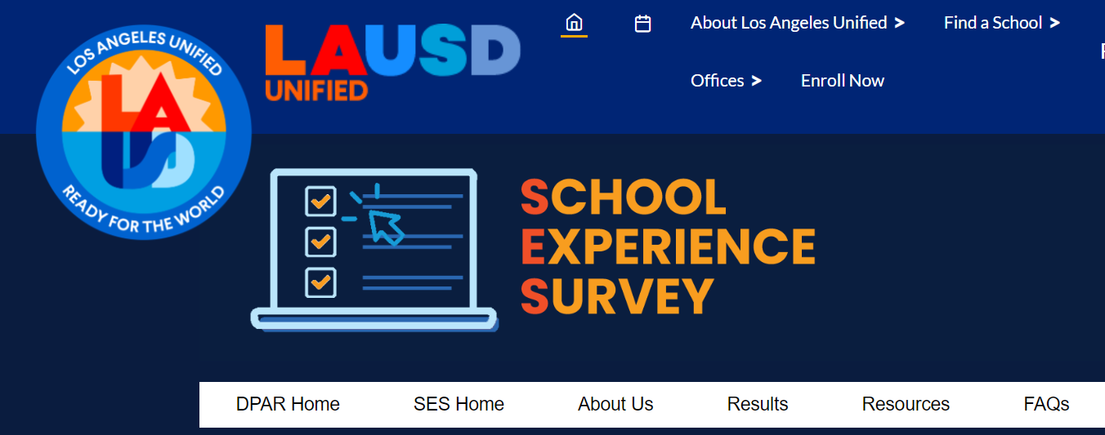
School Experience Survey – Results
  SES Results – Link

Slide 17

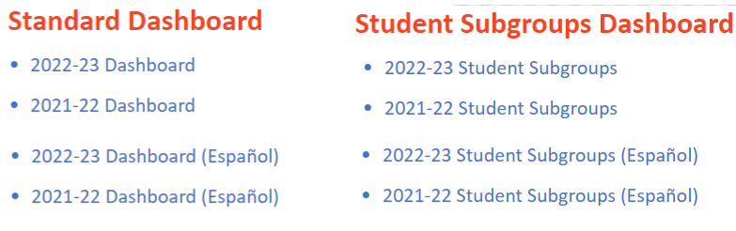
School Experience Survey – Results
  SES Results – Link

Slide 18
School Experience Survey – Results
  SES Results – Link
Most current SES data

Slide 19
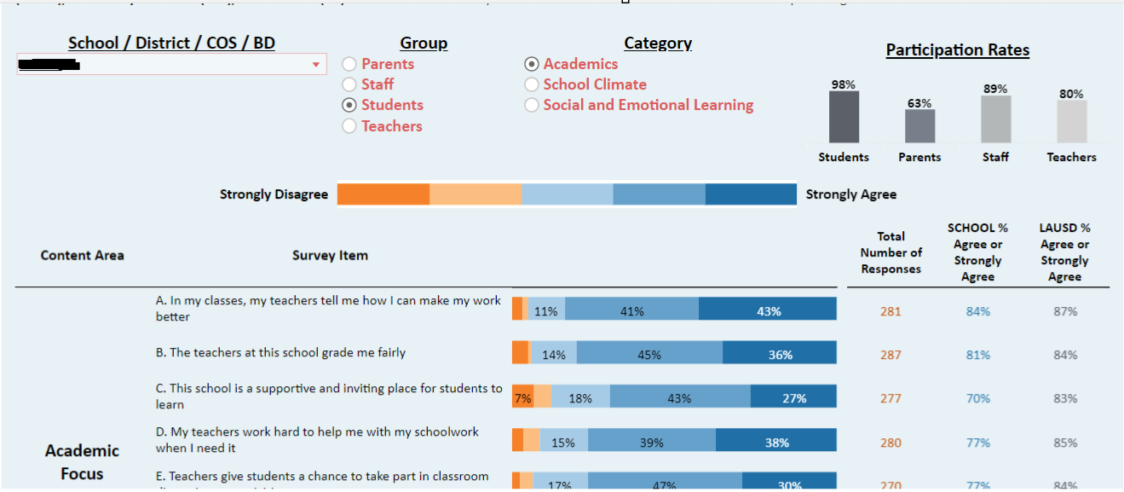
School Experience Survey – Results

Slide 20
School Experience Survey – Results
Drop down menu
Select School

Slide 21
School Experience Survey – Results
Select Group

Slide 22
School Experience Survey – Results
Select Category

Slide 23
School Experience Survey – Results
Color-coded scale:
Orange = Strongly Disagree
Dark Blue = Strongly Agree

Slide 24
School Experience Survey – Results
Participation rates for each group

Slide 25
School Experience Survey – Results
41% Agree + 43% Strongly Agree = 84%

Slide 26
School Experience Survey – Results
School vs. LAUSD (ES or MS or HS)

Slide 27
School Experience Survey – Results
Walkthrough Example!!
Click here to follow along

Slide 28
School Experience Survey - Agenda
DPAR team and services
Overview of the New School Experience Survey Webpage
SES Results – Overview and Walkthrough
LAUSD 2026 Strategic Goals
Strategies and tools to help meet our goals

Slide 29
School Experience Survey – Strategic Goals
LAUSD 2026 Strategic Goals
Increase the percentage of parents reporting on the School Experience Survey they feel welcome to participate at their school to 94% (from 86.3% in 2021-22)
Increase the percentage of families responding favorably on the School Experience Survey around overall customer service by 2% annually
Increase the percentage of parents reporting on the School Experience Survey that their school provides them with information they can understand to 96% (from 91.2% in 2021-22)
Increase the percentage of parents completing the annual School Experience Survey to 60% (from 52% in 2021-22)

Slide 30
School Experience Survey – Strategic Goals
LAUSD 2026 Strategic Goals
Increase the percentage of parents reporting on the School Experience Survey they feel welcome to participate at their school to 94% (from 86.3% in 2021-22)

Slide 31
School Experience Survey – Strategic Goals
LAUSD 2026 Strategic Goals
Increase the percentage of parents reporting on the School Experience Survey they feel welcome to participate at their school to 94% (from 86.3% in 2021-22)
Notes:
School A – Wright Eng Des Mag
School B – Verdugo Hills SH

Slide 32
School Experience Survey – Strategic Goals
LAUSD 2026 Strategic Goals
Increase the percentage of families responding favorably on the School Experience Survey around overall customer service by 2% annually
  10 Statements/Questions, such as:
    “Clerical/office staff take my concerns seriously”
    “I am greeted by school staff when I visit this school”
    “Clerical/office staff treat me with respect in-person and online”

Slide 33
School Experience Survey – Strategic Goals
LAUSD 2026 Strategic Goals
Increase the percentage of families responding favorably on the School Experience Survey around overall customer service by 2% annually

Slide 34
School Experience Survey – Strategic Goals
LAUSD 2026 Strategic Goals
Increase the percentage of parents reporting on the School Experience Survey that their school provides them with information they can understand to 96% (from 91.2% in 2021-22)

Slide 35
School Experience Survey – Strategic Goals
LAUSD 2026 Strategic Goals
Increase the percentage of parents reporting on the School Experience Survey that their school provides them with information they can understand to 96% (from 91.2% in 2021-22)
Notes:
School A – Roscomare Rd El
School B – 6th Ave El

Slide 36
School Experience Survey – Strategic Goals
LAUSD 2026 Strategic Goals
Increase the percentage of parents completing the annual School Experience Survey to 60% (from 41% in 2021-22)
Notes:
The original percentage of 52% reflected only elementary schools, not the entire district, which has since been corrected to reflect the accurate participation of 41% in 21-22.

Slide 37
School Experience Survey – Strategic Goals
LAUSD 2026 Strategic Goals
Increase the percentage of parents completing the annual School Experience Survey to 60% (from 41% in 2021-22)
Notes:
The original percentage of 52% reflected only elementary schools, not the entire district, which has since been corrected to reflect the accurate participation of 41% in 21-22.

Slide 38
School Experience Survey - Agenda
DPAR team and services
Overview of the New School Experience Survey Webpage
SES Results – Overview and Walkthrough
LAUSD 2026 Strategic Goals
Strategies and tools to help meet our goals
  Group Activity – Brainstorm and Share

Slide 39
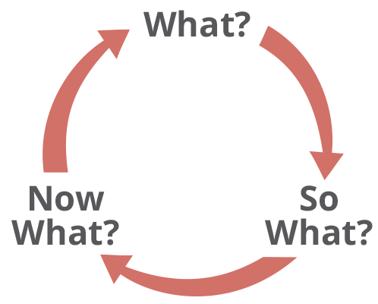
School Experience Survey – Strategies
  Identify an area to focus on and begin asking questions:
  What?
  What is the issue?
  What were your initial expectations?
  What outcome did you observe?
  What population is impacted?
  So What?
  Why is finding important?
  How is the finding different from what you expected?
  What impacts the way you view the findings?
  Now What?
  How can we address the issue?
  What seems to be the root cause(s) of the issue?
  What other work is currently happening to address the issue?
  What would you need to learn more about related to this issue?
  What follow-up is needed to address any challenges or difficulties?

Slide 40
School Experience Survey – Strategies
  Identify an area to focus on and begin asking questions:
What?
So What?
Now What?

Slide 41
School Experience Survey – Strategies
  Breakout Room Discussion - 15 Minutes
  Share and Discuss – 10 Minutes

Slide 42
School Experience Survey – Guide and Documents
  SES Guide and Documents – Link

Slide 43
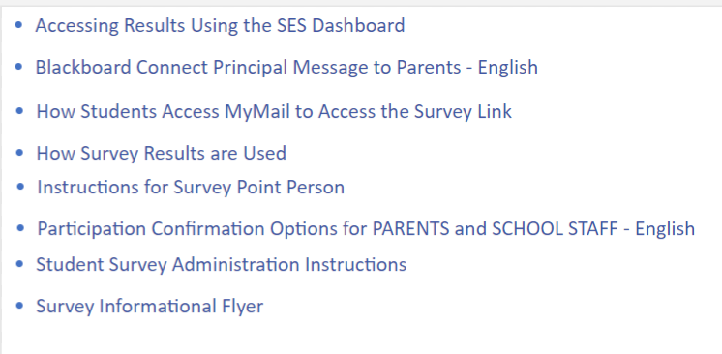
School Experience Survey – Guide and Documents
  SES Guide and Documents – Link

Slide 44

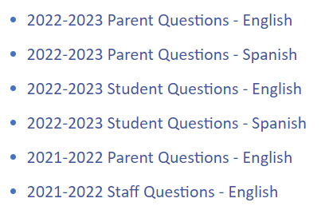
School Experience Survey – Guide and Documents
  SES Guide and Documents – Link

Slide 45
School Experience Survey Team
Contact Us
Data Privacy, Analysis and Reporting (DPAR)
School Experience Survey Team
Phone: 213-241-5600
Email: schoolexperiencesurvey@lausd.net
Notes:
Speaker: Text
Time: XX minutes
Purpose:
Text
Notes:
Text
Facilitator Moves:
Text

