Slide 1
Investigating Vertical Alignment in Measurement and Data and Math Practices 7 & 8
Notes:
Slide 1: Title Slide
(Time for PD is one 2-hour session, or can be split into 2 one-hour sessions)
Facilitator Notes: Have participants sit with colleagues who are from different grade levels. It would be ideal to have groups that have one teacher from each grade level, K-5.

Slide 2
Objectives
To deepen our understanding of the alignment of measurement and data concepts and how the CA Math Content Standards provide focus, coherence, and rigor in the Measurement and Data (MD) domain
To deepen our understanding of the Standards for Mathematical Practice 7 & 8
Notes:
Slide 2: Objectives
Time Allotted: 1 minute
Facilitator: Share objective with participants.

Slide 3
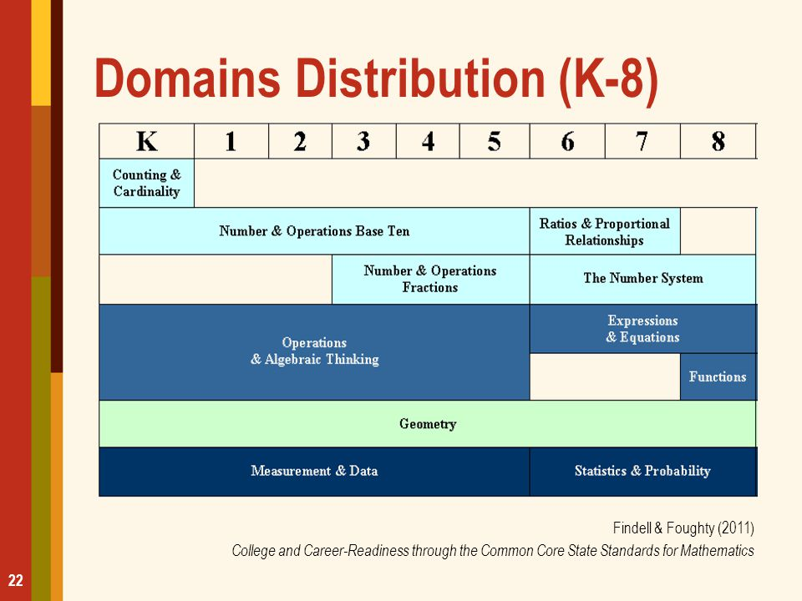
Math Domains
Notes:
Slide 3: Math Domains
Time Allotted: 1 minute
Facilitator:
“Today we will investigate vertical alignment in the Measurement and Data domain. As you can see in this table, the MD domain starts with Kindergarten and goes all the way to Grade 5.”

Slide 4
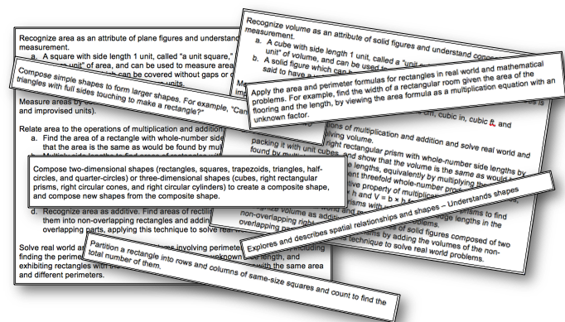
Big Idea: Understand the concept of area and how it connects to perimeter and volume
Notes:
Slide 4: Big Idea
Critical Point
The power of this process and tool is the collaborative conversation. It is not about just placing the standards in order or filling out the chart.
Time Allotted: 15 minutes
Step-By-Step Instructions
Tell participants:
We are going to engage in a study of the measurement standards using a modified vertical trajectory PK through Grade 5.
Pass out a sheet of chart paper and a set of the Geometric Measurement Standards Cards for each group. (The standards cards are on Facilitator Materials: Geometric Measurement Standards Cards. Prior to the session, a set of cards should be copied on cardstock, cut apart, and placed in a plastic bag, or paper clipped together, for each group.)
Tell participants:
For our study, we will be looking at a set of Geometric Measurement standards related to the Big Idea “Understand the concept of area and how it relates to perimeter and volume.”
Your group has a set of the selected standards that have been cut apart, each card containing the actual language of one or more of the standards from prekindergarten through grade 5, you will notice that the grade level and standard coding are not listed with the standard. Your group’s task is to read each of these standards and determine the order of the standards statements, from prekindergarten through grade 5. While you work, your group should discuss where you think each standard falls in the PK–5 progression, and determine what language from each of the standards helped you determine its placement. Be prepared to share and justify your placement of the standards with the whole group when time is up.

Slide 5
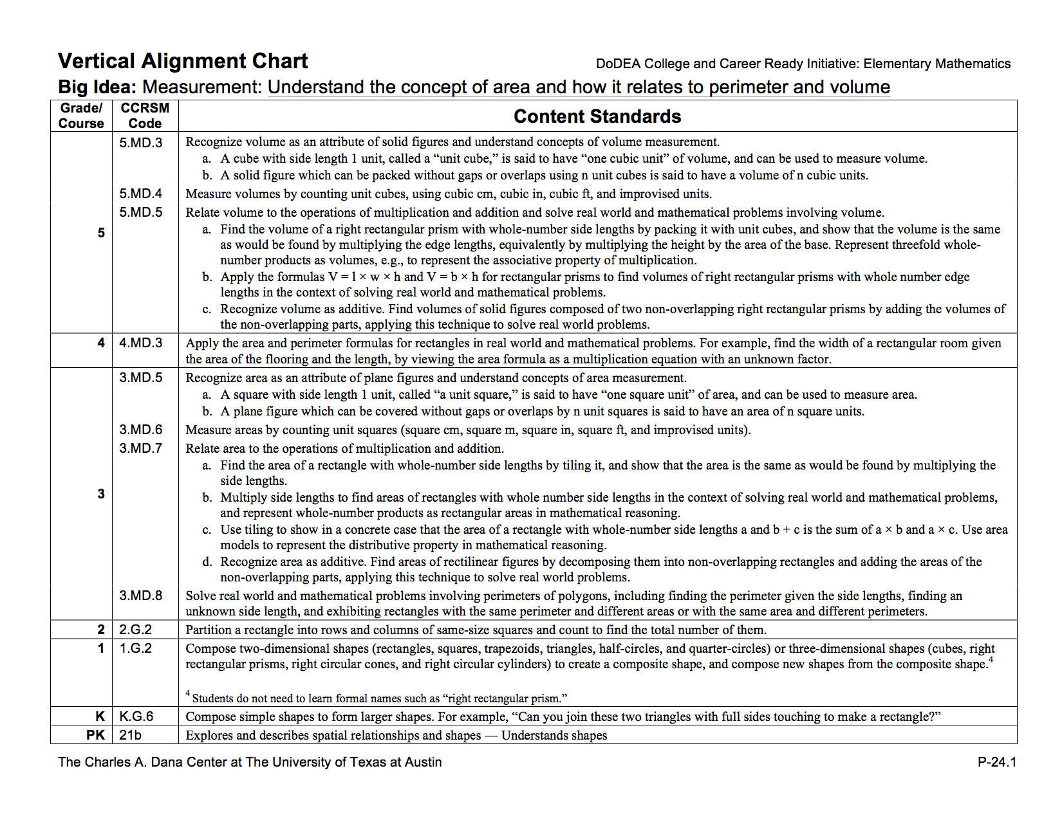
Big Idea: Understand the concept of area and how it connects to perimeter and volume
Notes:
Slide 5: Big Idea
Time Allotted: 5 minutes
Step-By-Step Instructions
Have groups compare their placement of the standards to the vertical alignment displayed on Hand Out #1 Vertical Alignment Chart: Big Idea: Measurement: Understand the concept of area and how it relates to perimeter and volume
Give participants a few minutes to make any changes to their placement of the standards, then have them glue the standards on the left side of a piece of chart paper. They should label each standard with its corresponding grade level and standard code, and leave space between each standard so that they can write some observations in the next step.

Slide 6
Investigating Vertical Alignment
As a group, analyze the trajectory, considering the following questions:
  What changes occur from grade to grade?
  Where are concepts introduced, developed, and finalized?
  Does an idea or skill get more complex, and if so, how?
Notes:
Slide 6: Investigating Vertical Alignment
Time Allotted: 5 minutes
Facilitator:
When groups finish placing all their strips on chart paper, have table groups gather at their group trajectories. Starting with the lower elementary grades, have each subgroup share some of the conversations they had while studying the standards and their justifications for the findings they noted on each grade-level strip with their table group.
Next, direct table groups to discuss the questions, have table groups record their answers on the right side of the chart. Tell participants that they may want to record additional observations and findings that surfaced during their discussions.
Allow time for table groups to share a few of their findings with the whole group.
Ask participants to return to their seats and have a short discussion about the shifts (focus, coherence, and rigor). Ask, “How did these key shifts surface during this learning experience?”
At this time, have participants take a second look at their big idea chart and modify it as needed. They may want to add information, delete, or edit what they originally thought.

Slide 7
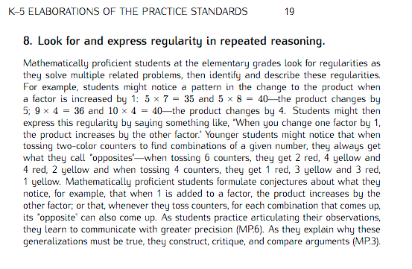
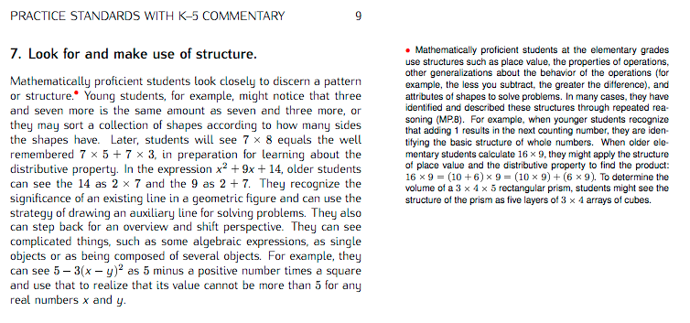
Looking for Evidence of the Math Practices
While you are reading, think about the following questions:
How will students engage in the mathematics through each of these SMPs?
What similarities do you see in student behaviors/actions as described in SMPs 7 and 8? What differences do you see?
Notes:
Slide 7: Looking for Evidence of the Math Practices
Time Allotted
10 minutes
Critical Point
Rigorous mathematics teaching and learning should intentionally integrate the Standards for Mathematical Practice with mathematics content.
Step-By-Step Instructions
Tell participants:. For this session, we will focus on SMPs 7 & 8. It is important to note that we are not expecting you to be experts on these two SMPs. This will be an ongoing conversation.
Pass out Hand Out #2 Standards for Mathematical Practice: Commentary and Elaborations for K–5.
Tell participants: Remember, the Commentary and Elaborations document for K–5 adapts the language of the SMPs in two different ways:
The first section provides the annotated version of the standards that provide additional interpretation of the standards appropriate for the K–5 classroom. This version helps educators understand how the original language of the standards applies in K–5.
The second section provides the elaborations of the standards. These are narrative descriptions that integrate the annotations from the first section and provide a coherent description of how the SMPs play out in the K–5 classroom.
Take a few minutes to read through either the Commentary version or the Elaboration version for both SMP 7 and SMP 8.
While you are reading, think about how students would engage in each of these.

Slide 8
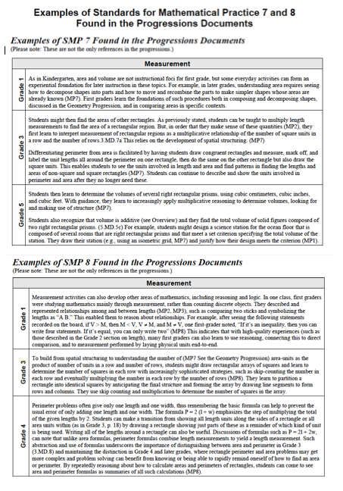
Looking for Evidence of the Math Practices
Use the handout to discuss:
How will students engage in the mathematics through each of these SMPs?
Similarities?
Differences?
Notes:
Slide 8: Looking for Evidence of the Math Practices
Time Allotted
5 minutes
Step-By-Step Instructions
Pass out Hand Out #3: SMP 7&8 in MD
Read the handout.
Have groups share out some of the student behaviors/actions that they expect to see for SMPs 7 & 8 in the content area of MD. Some possible responses include:
SMP 7
Students will observe and identify shapes in the real world.
Students will identify defining attributes of shapes.
Students will compose and decompose shapes.
SMP 8
Students sort and classify shapes based on attributes.
Student describe similarities and differences between shapes and shape categories.
Students develop formulas based on repeated reasoning of how to calculate in order to solve problems, such as those involving area and perimeter.

Slide 9
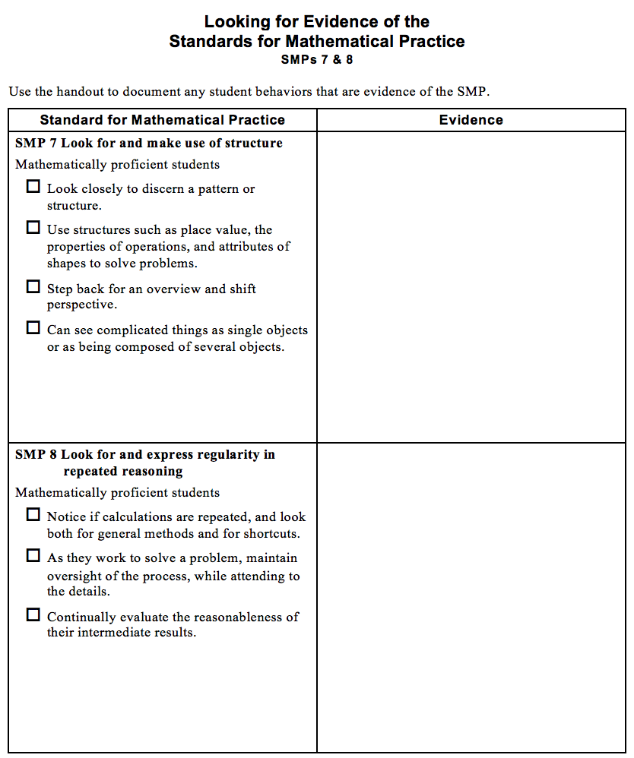
Connections to Math Practices 7 & 8
Use the handout to:
Check off any behaviors/actions that you or your group members display as you engage in the math task; and
Record any observations you make that serve as evidence for the observed behaviors/actions.
Notes:
Slide 9: Connections to Math Practices 7 & 8
Time Allotted: 2 minutes
Step-By-Step Instructions
Pass out Hand out #4 Looking for Evidence of the Standards for Mathematical Practice: SMPs 7 & 8
Give participants a few moments to reorient themselves to the handout.
Tell participants:
You will be looking for evidence of the student behaviors described in selected SMPs as you engage in a mathematical task.
Remember, the left-hand column of this handout contains the narrative description of one or more SMPs. In this case, our focus will be on SMP 7 Look for and make use of structure and SMP 8 Look for and express regularity in repeated reasoning.
You will check off any of the student actions (described in the narrative for SMPs 7 & 8) that you observe while engaging in the task.
The right-hand column should be used to document observations of any specific actions.

Slide 10
Math Learning Experience 1
Toby has some wooden boards to put around a rectangular sandbox he is building. He wants to know all the possible sized sandboxes he could build with the boards that he has.
What do you know?
What do you need to know?
Notes:
Slide 10: Math Learning Experience 1
Critical Point
Students are often confused by the concepts of area and perimeter because both involve measuring regions, and students are often taught formulas for both without allowing for conceptual
understanding of either.
Time Allotted: 30 minutes (three slides of the task)
Step-By-Step Instructions
Tell participants:
It is time to engage in a couple of quick math learning experiences.
Think about not only how the learning experiences align to SMPs 7 & 8 but also how the promotes access and equity in the math classroom.
Take a few moments to read the slide.
Based on what you just read in the problem, what do we know?
If necessary, use probing questions to help participants notice the following:
The box will be a rectangle.
Toby has a set amount of wood.
He wants to know all the possible sizes of sandboxes he can make.
There is more than one answer.
Give groups time to determine the information they will need to solve the problem.
Have a few groups share out the information they think they will need to solve this problem. [The amount of wood that Toby has.] (Continued on next slide)

Slide 11
Math Learning Experience 1
Toby has 16 feet of wooden boards to put around a rectangular sandbox he is building. He wants to know all the possible sized sandboxes he could build with the boards that he has.
Measure the sides in whole feet
Notes:
Slide 11: math Learning Experience 1 (continued)
Tell participants:
First, you need to know that Toby has only 16 feet of wooden boards. He will not buy more, and he plans to use all the wood in building his sandbox
Second, you need to know that all measurements that Toby uses will be in whole feet. For example, there will not be a side that measures 6 feet 3 inches. It will either be 6 feet or 7 feet.
Now, work with your group to determine solutions to Toby’s problem.
We have also provided a sheet of graph paper, Pass out Hand Out #5: Graph Paper
In about 10 minutes, your group should be ready to explain your possible solutions & how you figured them out.
While groups are working, walk around and observe the various size sandboxes the groups come up with.
As you come across a group with one of the possible sizes, give that group a pack of sticky notes and a piece of chart paper and ask them to use the sticky notes on the chart paper to build an array representing that sandbox. Ask them not to write anything on the chart paper; just build the array with the sticky notes. For this activity, there are 4 different representations, so keep an eye out to ensure that all 4 are represented by the end of the activity. (Most groups will come up with several possibilities; be selective with which array you ask each group to build.)
You will also want to make note of anyone using strategies to find the perimeter, such as with a formula.
Call the participants back to the whole group and 1 at a time, starting with the sandbox with the smallest area
(1 x 7 feet ) and working up to the largest (4 x 4 feet), have the group who built each representation post their chart paper. (Continued on next slide)

Slide 12
Math Learning Experience 1
Toby has 16 feet of wooden boards to put around a rectangular sandbox he is building. He wants to know all the possible sized sandboxes he could build with the boards that he has.
Measure the sides in whole feet
Notes:
Slide 12: Math Learning Experience 1, Step-By-Step Instructions (continued from previous slide)
Illustrate by drawing and counting lines along the outer edge of each sticky note to show that there are 16 linear feet of wood around the 1-x-7-foot box.
Explain to participants:
When calculating the outside measurement of a figure, also called its perimeter, you are adding up the linear feet that go around the figure.
This process of drawing and counting lines along the outer edge of the figure helps those students who want to count the squares in the figure to determine perimeter to get the distinction between area and perimeter — a common area of confusion.
Below the figure on your chart paper write ”Perimeter = 16 feet”
Say: “I noticed this group had another way to calculate the perimeter. Can you share your strategy with us?”
Possible responses include: 7 + 7 + 1 + 1 = 16 or (2 x 7) + (2 x 1) = 16
Write the equation on the chart paper under the perimeter.
Follow this same routine for each of the other possible sandboxes (2-by-6, 3-by-5, and 4-by-4 feet).
Say ”If Toby wanted to build the largest size sandbox possible with his wooden boards, which one would it be? How do you know?”
Participants should come to the conclusion that the larger the area, the larger the sandbox.
Refer back to the 1-by-7 set of sticky notes and say:
How would you describe the size of this box? [7 square feet]
When we are referring to the size of the sandbox we are referring to its area.
Under the figure on your chart paper write, “Area = 7 square feet”
Repeat this conversation for each of the other rectangles.
Ask, “What do you notice about the shape of the rectangle in relation to its area?” (Participants should notice that the largest area belongs to the shape that is a square.)

Slide 13
Math Learning Experience 2
Marcy is making a rectangular pen for her rabbits. The pen must be 16 square feet in size. She needs to know all the different ways to build her pen so that she can decide how much fencing to buy to go around it.
What do you know?
What do you need to know?
Notes:
Slide 13: Math Learning Experience 2, Step-By-Step Instructions
Time Allotted: 25 minutes (two slides of the task)
Tell participants:
We are going to solve another problem, but this one is a little different.
Take a few moments to read the slide.
Based on what you just read in the problem, what do we know?
The pen will be a rectangle.
It must have an area of 16 square feet.
Marcy wants to know all the possible sizes of pens she can make, there is more than one answer
She needs to know how much fencing to buy to go around the pen.
Tell participants:
Once again, you need to use only whole feet measurements for all your calculations.
Now, work with your group to determine a solution to Marcy’s problem.
You may use graph paper to keep track of your work.
Allow about 10 minutes for groups to work on their solutions.
While groups are working, walk around and observe the various size pens the groups come up with.
Continued on next slide.

Slide 14
Math Learning Experience 2
Marcy is making a rectangular pen for her rabbits. The pen must be 16 square feet in size. She needs to know all the different ways to build her pen so that she can decide how much fencing to buy to go around it.
What do you know?
What do you need to know?
Notes:
Slide 14: Math Learning Experience 2, Step-By-Step Instructions (continued from previous slide)
Ask group to build an array representing that pen using the sticky notes on the chart paper. (The 1-by-16 pen will need two sheets of chart paper.) Ask them not to write anything on their chart yet — just build the array with the sticky notes.
For this activity, there are 3 different representations, 1X16, 2X8, 4X4
Ask the group who built the pen with the smallest amount of fencing (4 by 4) to come put up their chart.
Ask participants, “Can anyone prove that this pen is 16 square feet in size?”
Allow one or two participants to share their thinking.
As they share, use the same process that was used in the previous problem, count and label the notes, label the dimensions, Write the equation “4 x 4 = 16” and add “Area = 16 square feet” under the figure.
Ask participants, “What measurement do you think I am referring to when I ask how much fencing will Marcy need to go around this pen?” [perimeter]
Ask participants to prove the area and perimeter for each, label the figure to show perimeter and area, and document the equations for both area and perimeter.
Once you have completed your discussion with each figure, ask participants, “What do you notice about the shape of the rectangle in relation to its perimeter?”

Slide 15
Reflection on Area and Perimeter
What observations can you make about the relationship between the perimeter of a rectangle and the area of a rectangle?
If you were given a rectangle with a certain perimeter, how would you draw it so that it has the greatest area?
If you were given a rectangle with a certain area, how would you draw it so that it had the greatest perimeter?
Notes:
Slide 15: Reflection on Area and Perimeter
Time Allotted: 8 minutes
Step-By-Step Instructions
Tell participants:
I would like to give you the opportunity to make and share some observations about the two different problems in which you just engaged.
In the first problem, you had a fixed perimeter of 16 feet, and you determined the area, from least to greatest, of each sandbox that could be made with that perimeter.
In the second problem, you had a fixed area of 16 square feet, and you determined the perimeter, from least to greatest, of each rabbit pen that could be made with that area.
Now, take a few moments to think about the relationship between the perimeter and the area with these guiding questions: READ Slide
Using the figures we built on the chart paper as helpful, discuss with your group your observations about the relationship between the perimeter of a rectangle and the area of a rectangle.
Ask two or three groups to share their thinking.
This discussion should surface the following relationships:
The more square (“fatter”) a rectangle is, the larger its area and the smaller its perimeter.
In contrast, the longer and “skinnier” a rectangle is, the smaller its area and the larger its perimeter.
To transition to the next slide, ask participants, “How did the framing of this math learning allow for Equity and access in the classroom?”

Slide 16
Connections to Math Practices 7 & 8
Use the handout to:
Check off any behaviors/actions that you or your group members display as you engage in the math task; and
Record any observations you make that serve as evidence for the observed behaviors/actions.
Notes:
Slide 16: Connections to Math Practices 7 & 8
Critical Point
Rigorous mathematics teaching and learning should intentionally integrate the Standards for Mathematical Practice with mathematics content.
Time Allotted: 8 minutes
Step-By-Step Instructions
Remind participants that they were asked to use this Hand Out #4 Looking for Evidence of the Standards for Mathematical Practice: SMPs 7 & 8) to document evidence of their own engagement in SMPs 7 & 8 throughout the area and perimeter tasks.
Give participants a couple minutes to revisit this page and discuss in their groups evidence they noticed of their own engagement in these SMPs during the tasks.
Have a few participants share out their observations.

Slide 17

Teaching and Learning Framework
Standard 1a1: Knowledge of Content and the Structure of the Discipline
Standard 3a4: Use of Academic Language
Notes:
Slide 17: Teaching and Learning Framework
Time Allotted
1 minute
Step-By-Step Instructions
Make connections to the Teaching and Learning Framework, specifically Standards 1a1: Knowledge of Content and the Structure of the Discipline and Standard 3a4: Use of Academic Language.
Ask participants where they saw connections to the Teaching and Learning Framework.

Slide 18
Investigating Vertical Alignment
Reflection
How does studying standards across grade levels influence what I do in my classroom?
How does studying the standards in this way support my understanding of the key shifts of coherence, focus, and rigor?
Notes:
Slide 18: Reflection
Time Allotted: 5 minutes
Facilitator:
Give participants 1 minute to reflect individually and silently about the questions on the slide, then have them discuss the questions with those at their tables.
Ask groups to share out a few of their conversation points.
Some of the important ideas that should be surfaced include:
#1 — It is important that we, as teachers, spend collaborative time studying the standards to ensure horizontal and vertical alignment. In addition, studying the standards can be used as a structure that supports differentiation and allows us to fill gaps in student learning.
#2 — Investigating how a big idea changes and grows across multiple grade levels speaks to the coherence of the standards. This investigation helps educators determine the grade level(s) at which the big idea is a critical area of focus. In addition, studying the standards helps educators determine the grade levels at which rigor—conceptual understanding, procedural skills, and fluency—is develop
Remove one of the strips from the chart and ask, “What happens if a teacher decides not to teach one or more standards?” Popcorn some responses.
Summarize by reminding participants that studying the standards is a continuous journey, and alignment is an ideal state. Thank you for participating.

