Slide 1
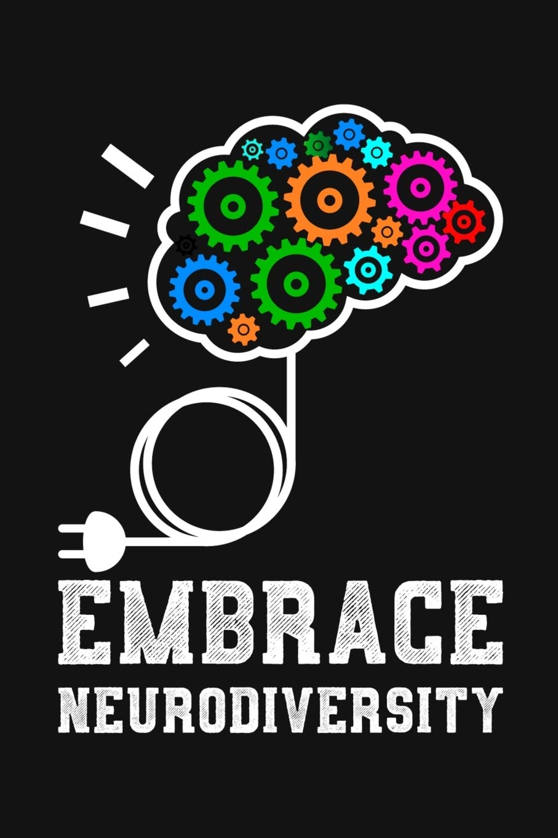
Neurodiversity
Human Relations, Diversity & Equity
Notes:
https://achieve.lausd.net/human-relations

Slide 2
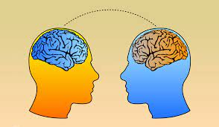
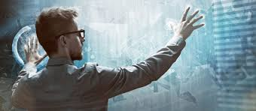
Would you rather…
be able to read minds
or know the future?

Slide 3
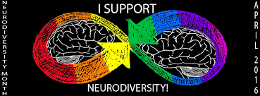
March is
Neurodiversity Awareness Month

Slide 4
What is neurodiversity?
Neurodiversity is a viewpoint that brain differences are normal, rather than deficits.
The idea of neurodiversity can have benefits for kids with learning and thinking differences.
This concept can help reduce stigma around learning and thinking differences.

Slide 5
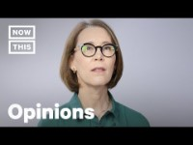
Human Neurodiversity
Notes:
https://youtu.be/aWxmEv7fOFY 3:15

Slide 6
About 15% of people could be considered neurodiverse
Developmental Coordination Disorder (DCD or dyspraxia)
Dyslexia
Attention Deficit Hyperactivity Disorder (ADHD)
Dyscalculia
Autistic Spectrum (ASD)
Tourette Syndrome (TS), and others

Slide 7
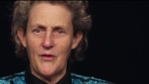
What it feels like to be autistic
Notes:
https://youtu.be/1qPFAT4p8Lc (2:11)

Slide 8

EXPERT
If you could be an expert at anything, what would it be?

Slide 9
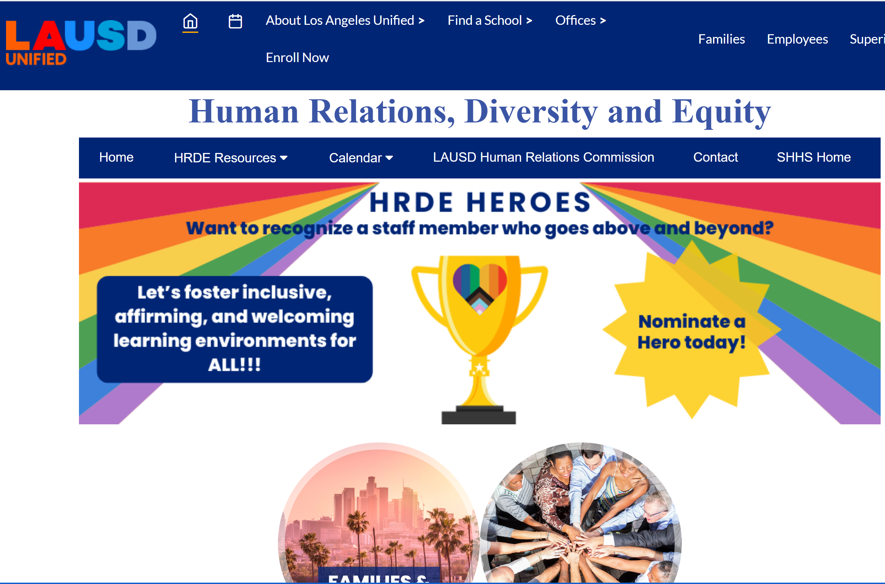
Human Relations, Diversity & Equity

Slide 10
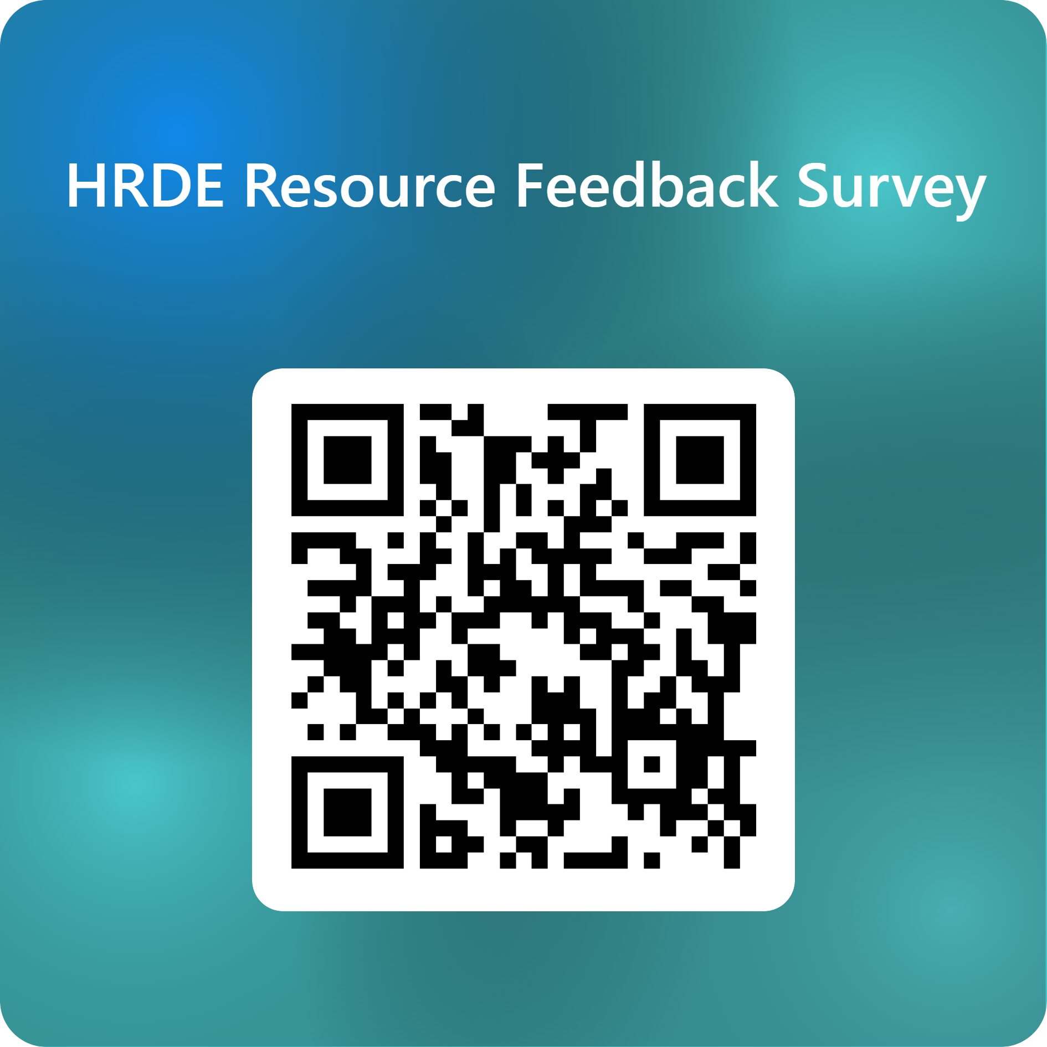
Teacher Survey
Notes:
Teacher, please scan the QR code or click the link below to complete a brief survey.
https://forms.office.com/Pages/ResponsePage.aspx?id=oUAqBCixxEqGSAFv-hIUh7oXrttstiBCsAXIu5FQ_QRUN09SMFZDT0FaNE9PSTBRTk9CME42WURWUy4u

